Slide 1
Ephesians 1:3-6
“Blessed is the God and Father of our Lord Jesus Christ, who has blessed us with every spiritual blessing in the heavenly realms in Christ, just as He chose us in him before the foundation of the world to be holy and blameless before Him. In love, he predestined us to adoption through Jesus Christ to himself, according to the good pleasure of his will— to the praise of the glory of his grace, with which he has highly favored us in the Beloved.”

Slide 2
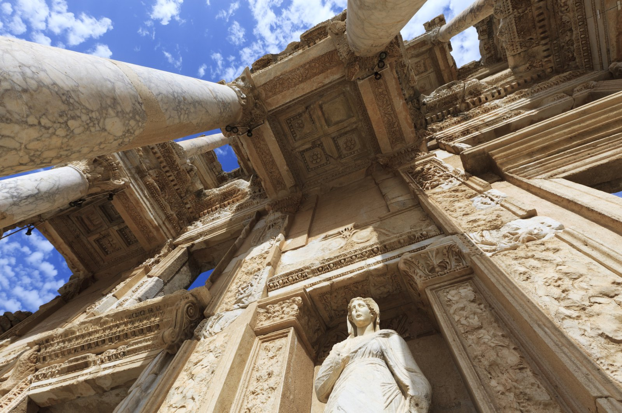
Paul’s Letter to the Ephesians
1:5-6

Slide 3
Ephesians 1:3-6
“Blessed is the God and Father of our Lord Jesus Christ, who has blessed us with every spiritual blessing in the heavenly realms in Christ, just as He chose us in him before the foundation of the world to be holy and blameless before Him. In love, he predestined us to adoption through Jesus Christ to himself, according to the good pleasure of his will— to the praise of the glory of his grace, with which he has highly favored us in the Beloved.”

Slide 4
Ephesians 1:3-6
“Blessed is the God and Father of our Lord Jesus Christ, who has blessed us with every spiritual blessing in the heavenly realms in Christ, just as He chose us in him before the foundation of the world to be holy and blameless before Him. In love, he predestined us to adoption through Jesus Christ to himself, according to the good pleasure of his will— to the praise of the glory of his grace, with which he has highly favored us in the Beloved.”

Slide 5
Ephesians 1:5-6
“In love, he predestined us to adoption through Jesus Christ to himself, according to the good pleasure of his will— to the praise of the glory of his grace, with which he has highly favored us in the Beloved.”

Slide 6
Ephesians 1:5-6
“In love, he predestined us to adoption through Jesus Christ to himself, according to the good pleasure of his will— to the praise of the glory of his grace, with which he has highly favored us in the Beloved.”

Slide 7
Ephesians 1:5-6
“In love, he predestined us to adoption through Jesus Christ to himself, according to the good pleasure of his will— to the praise of the glory of his grace, with which he has highly favored us in the Beloved.”

Slide 8
Ephesians 1:5-6
“In love, he predestined us to adoption through Jesus Christ to himself, according to the good pleasure of his will— to the praise of the glory of his grace, with which he has highly favored us in the Beloved.”

Slide 9
Ephesians 1:5-6
“In love, he predestined us to adoption through Jesus Christ to himself, according to the good pleasure of his will— to the praise of the glory of his grace, with which he has highly favored us in the Beloved.”

Slide 10
Ephesians 1:5-6
“In love, he predestined us to adoption through Jesus Christ to himself, according to the good pleasure of his will— to the praise of the glory of his grace, with which he has highly favored us in the Beloved.”

Slide 11
Ephesians 1:5-6
“In love, he predestined us to adoption through Jesus Christ to himself, according to the good pleasure of his will— to the praise of the glory of his grace, with which he has highly favored us in the Beloved.”

Slide 12
Ephesians 1:5-6
“In love, he predestined us to adoption through Jesus Christ to himself, according to the good pleasure of his will— to the praise of the glory of his grace, with which he has highly favored us in the Beloved.”

Slide 14
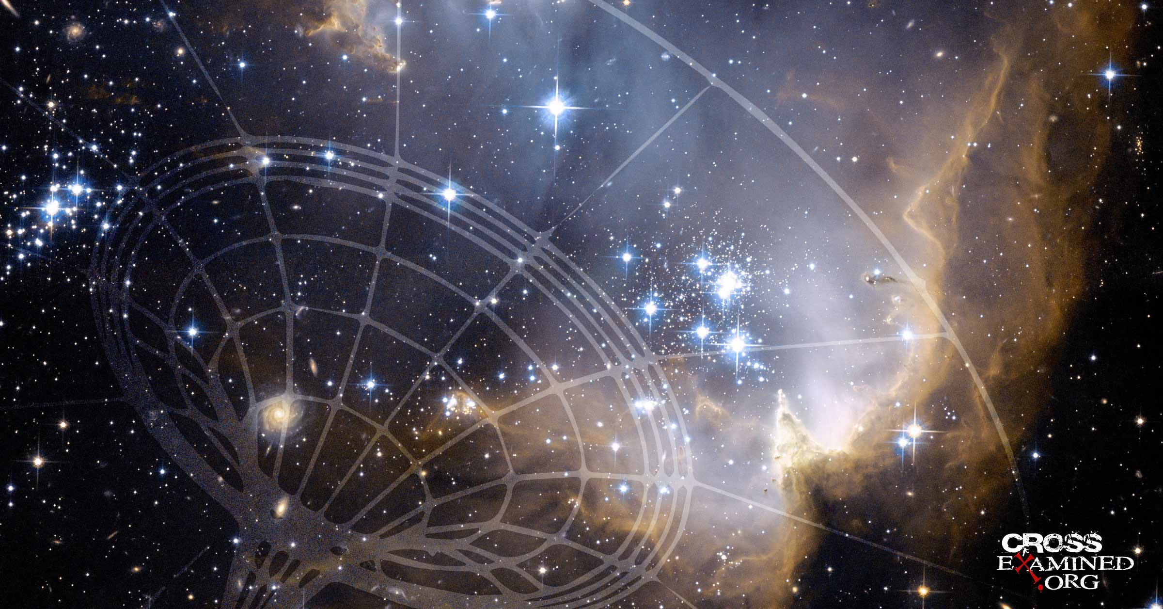

Slide 16
“predestined”
προορίζω

Slide 17
Romans 8:28-29
“And we know that in all things God works for the good of those who love him, who have been called according to his purpose. For those God foreknew he also predestined to be conformed to the image of his Son, that he [Jesus] might be the firstborn among many brothers and sisters.”

Slide 18
Adoption
υἱοθεσία

Slide 19
Ephesians 1:5-6
“In love, he predestined us to adoption through Jesus Christ to himself, according to the good pleasure of his will— to the praise of the glory of his grace, with which he has highly favored us in the Beloved.”

Slide 21
Ephesians 1:5-6
“In love, he predestined us to adoption through Jesus Christ to himself, according to the good pleasure of his will— to the praise of the glory of his grace, with which he has highly favored us in the Beloved.”

Slide 22
Ephesians 1:5-6
“In love, he predestined us to adoption through Jesus Christ to himself, according to the good pleasure of his will— to the praise of the glory of his grace, with which he has highly favored us in the Beloved.”

Slide 23
Ephesians 1:5-6
“In love, he predestined us to adoption through Jesus Christ to himself, according to the good pleasure of his will— to the praise of the glory of his grace, with which he has highly favored us in the Beloved.”

Slide 25
To give your offerings online, you can do so at:
holytrinitychico.org
To give you offerings via check, please mail them to:
Holy Trinity Church
1394 Huggins Ave.
Chico, CA 95926

