Slide 1
Ephesians 1:13-14
“ ¹³ In Him you also, having heard the word of truth, the gospel of your salvation, in whom having also believed, you were sealed with the Holy Spirit of promise, ¹⁴ who is the initial installment of our inheritance until the redemption of the purchased possession, to the praise of His glory.”

Slide 2
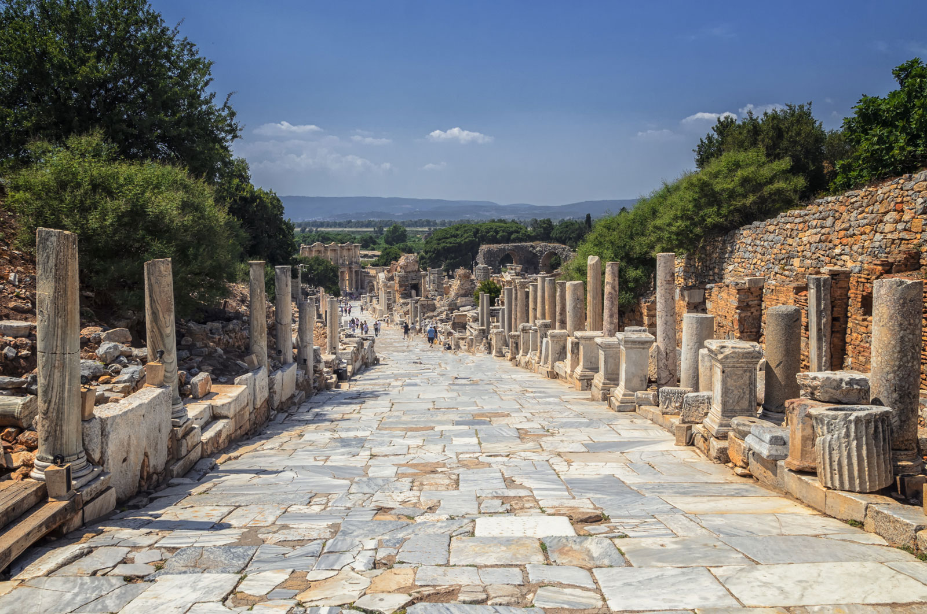
Paul’s Letter to the Ephesians
1:13-14

Slide 3
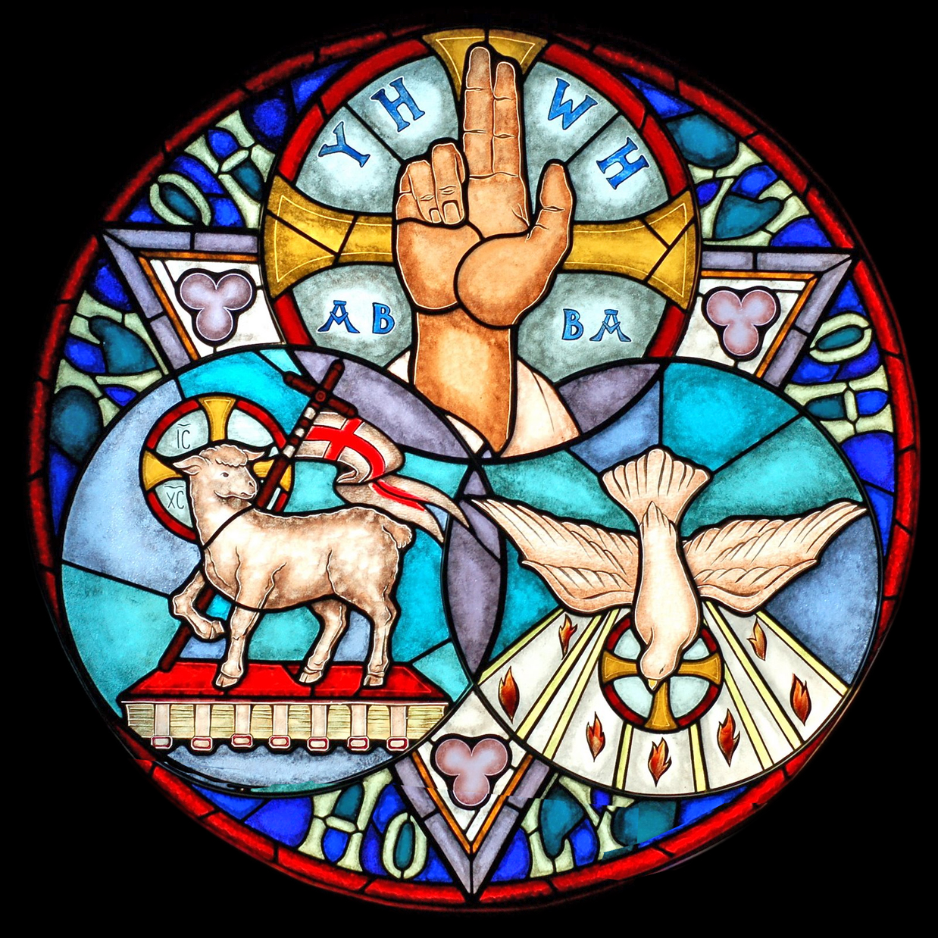
From the Father
vv. 3-6
choosing, adopting

Slide 4
From the Father
vv. 3-6
choosing, adopting
In the Son
vv. 7-12
redeeming, forgiving

Slide 5
From the Father
vv. 3-6
choosing, adopting
In the Son
vv. 7-12
redeeming, forgiving
Through the Spirit
vv. 13-14
sealing, assuring

Slide 6
Ephesians 1:13-14
“ ¹³ In Him you also, having heard the word of truth, the gospel of your salvation, in whom having also believed, you were sealed with the Holy Spirit of promise, ¹⁴ who is the initial installment of our inheritance until the redemption of the purchased possession, to the praise of His glory.”

Slide 7
Ephesians 1:13-14
“ ¹³ In Him you also, having heard the word of truth, the gospel of your salvation, in whom having also believed, you were sealed with the Holy Spirit of promise, ¹⁴ who is the initial installment of our inheritance until the redemption of the purchased possession, to the praise of His glory.”

Slide 8
Ephesians 1:13-14
“ ¹³ In Him you also, having heard the word of truth, the gospel of your salvation, in whom having also believed, you were sealed with the Holy Spirit of promise, ¹⁴ who is the initial installment of our inheritance until the redemption of the purchased possession, to the praise of His glory.”

Slide 9
Ephesians 1:13-14
“ ¹³ In Him you also, having heard the word of truth, the gospel of your salvation, in whom having also believed, you were sealed with the Holy Spirit of promise, ¹⁴ who is the initial installment of our inheritance until the redemption of the purchased possession, to the praise of His glory.”

Slide 10
Ephesians 1:13-14
“ ¹³ In Him you also, having heard the word of truth, the gospel of your salvation, in whom having also believed, you were sealed with the Holy Spirit of promise, ¹⁴ who is the initial installment of our inheritance until the redemption of the purchased possession, to the praise of His glory.”

Slide 11
Acts 1:4-5
“On one occasion, while he was eating with them, he gave them this command: ‘Do not leave Jerusalem, but wait for the gift my Father promised, which you have heard me speak about. For John baptized with water, but in a few days you will be baptized with the Holy Spirit’.”

Slide 12
Ezekiel 36:26-27
“I will give you a new heart and put a new spirit in you; I will remove from you your heart of stone and give you a heart of flesh. And I will put my Spirit in you and move you to follow my decrees and be careful to keep my laws.”

Slide 13
John 14:16-17
“And I will ask the Father, and he will give you another Helper to be with you forever— the Spirit of truth. The world cannot accept him, because it neither sees him nor knows him. But you know him, for he lives with you and will be in you.”

Slide 14
“sealed”
σφραγίζω

Slide 15
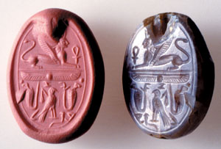

Slide 16
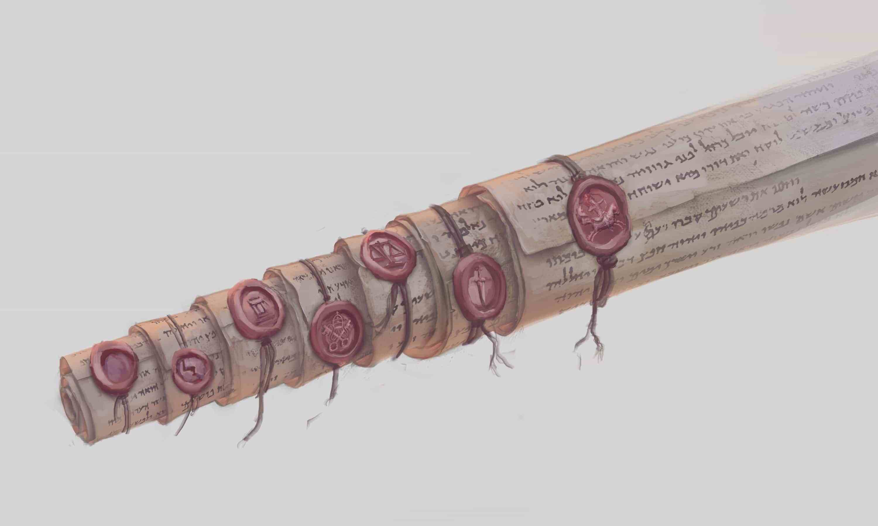
Security

Slide 17
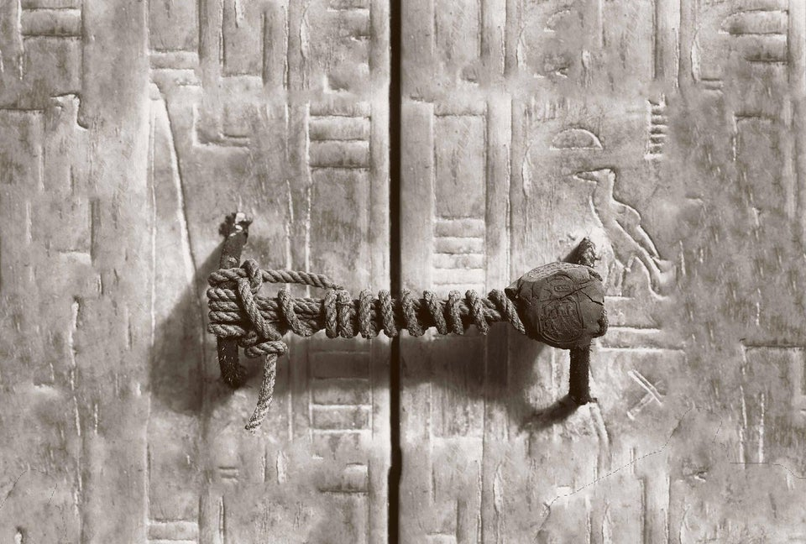

Slide 18
John 10:27-29
²⁷ “My sheep listen to my voice; I know them, and they follow me. ²⁸ I give them eternal life, and they shall never perish; no one will snatch them out of my hand. ²⁹ My Father, who has given them to me, is greater than all; no one can snatch them out of my Father’s hand.”

Slide 19
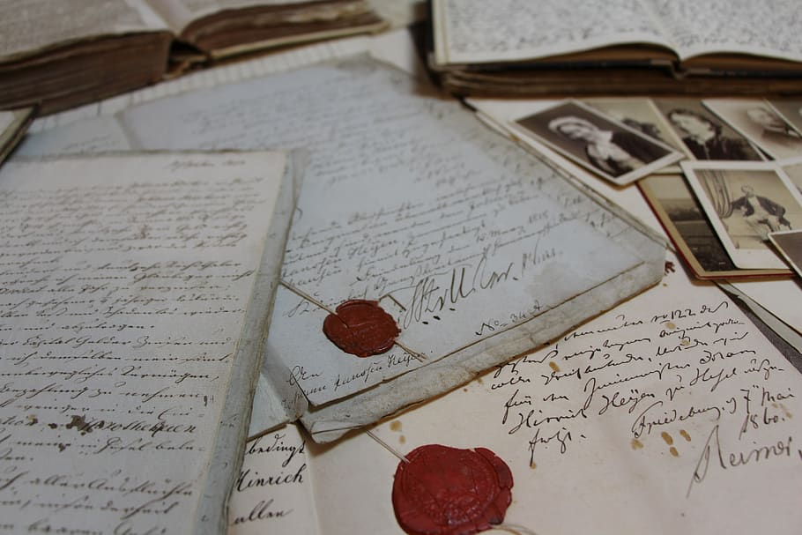
Authenticity

Slide 20
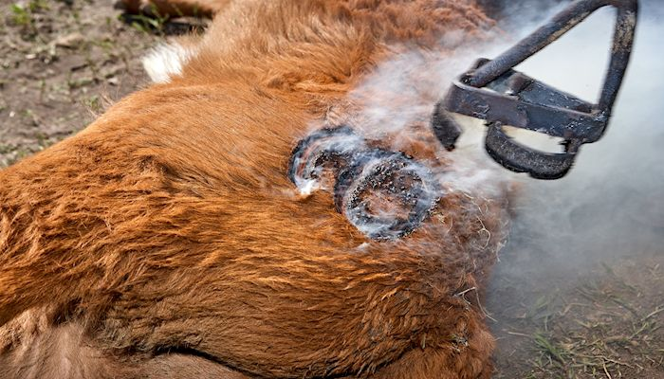
Ownership

Slide 21
Baptizing

Slide 22
Galatians 3:27
“For all of you who were baptized into Christ have clothed yourselves with Christ.”
1 Corinthians 12:13
“By one Spirit we were all baptized into one body.”

Slide 23
Indwelling

Slide 24
1 Corinthians 6:16-17
“Do you not know that he who unites himself with a prostitute is one with her in body? For it is said, ‘The two will become one flesh.’ But whoever is united with the Lord is one with him in spirit.”

Slide 25
Romans 8:9
“If anyone does not have the Spirit of Christ, they do not belong to Christ.”

Slide 26
Filling

Slide 27
Ephesians 5:18
“Do not get drunk on wine, which leads to debauchery. Instead, be filled with the Spirit.”

Slide 28
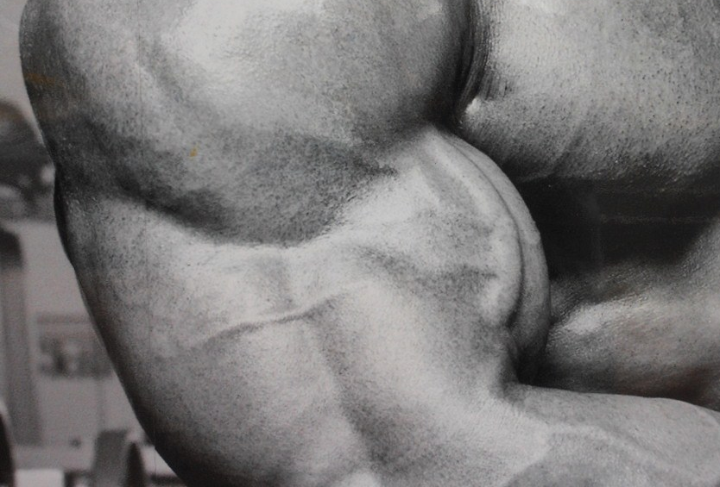
Empowering

Slide 29
1 Corinthians 14:1
“Eagerly desire the greater gifts, especially that you may prophesy”

Slide 30
Ephesians 1:13-14
“ ¹³ In Him you also, having heard the word of truth, the gospel of your salvation, in whom having also believed, you were sealed with the Holy Spirit of promise, ¹⁴ who is the initial installment of our inheritance until the redemption of the purchased possession, to the praise of His glory.”

Slide 31
2 Corinthians 1:21-22
“Now it is God who makes both us and you stand firm in Christ. He anointed us, set his seal on us, and given us his Spirit in our hearts as the first installment of our final purchase.”

Slide 32
Ephesians 1:13-14
“ ¹³ In Him you also, having heard the word of truth, the gospel of your salvation, in whom having also believed, you were sealed with the Holy Spirit of promise, ¹⁴ who is the initial installment of our inheritance until the redemption of the purchased possession, to the praise of His glory.”

Slide 34
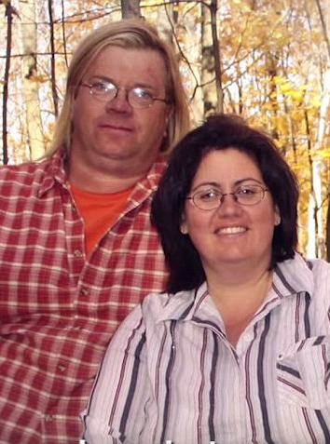
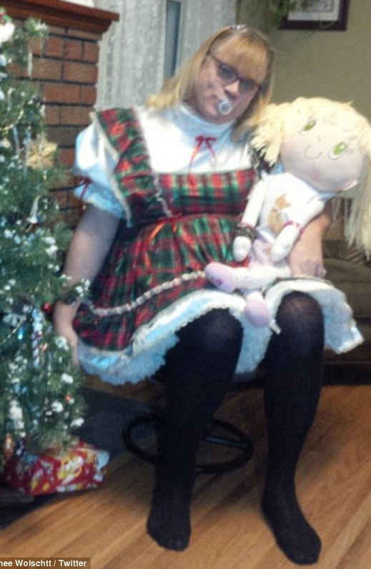

Slide 40
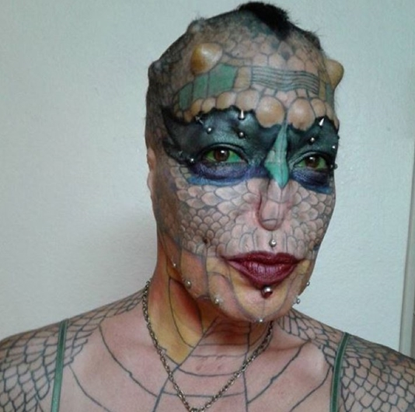

Slide 41
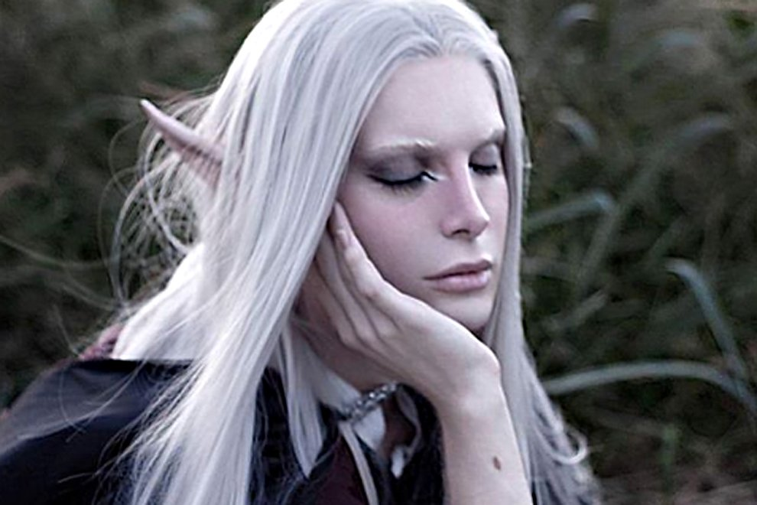

Slide 46
To give your offerings online, you can do so at:
holytrinitychico.org
To give you offerings via check, please mail them to:
Holy Trinity Church
1394 Huggins Ave.
Chico, CA 95926

