Slide 1
Ephesians 1:18-23
“I pray that the eyes of your heart may be enlightened in order that you may know the hope to which he has called you, the riches of the glory of his inheritance in his holy ones, and his incomparably great power for us who believe. That power is the same as the mighty strength he exerted when he raised Christ from the dead and seated him at his right hand in the heavenly realms, far above all rule and authority, power and dominion, and every name that is named, not only in the present age but also in the one to come. And God placed all things under his feet and appointed him to be head over everything for the church, which is his body, the fullness of him who fills everything in every way.”

Slide 2
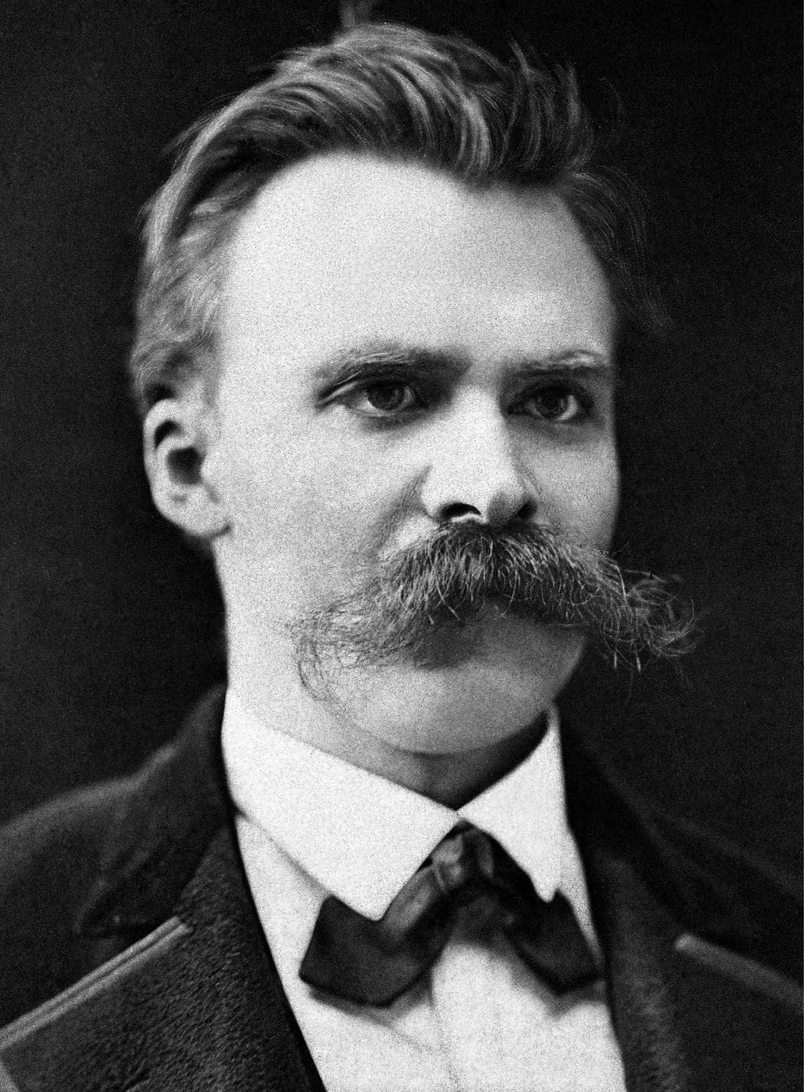

Slide 3
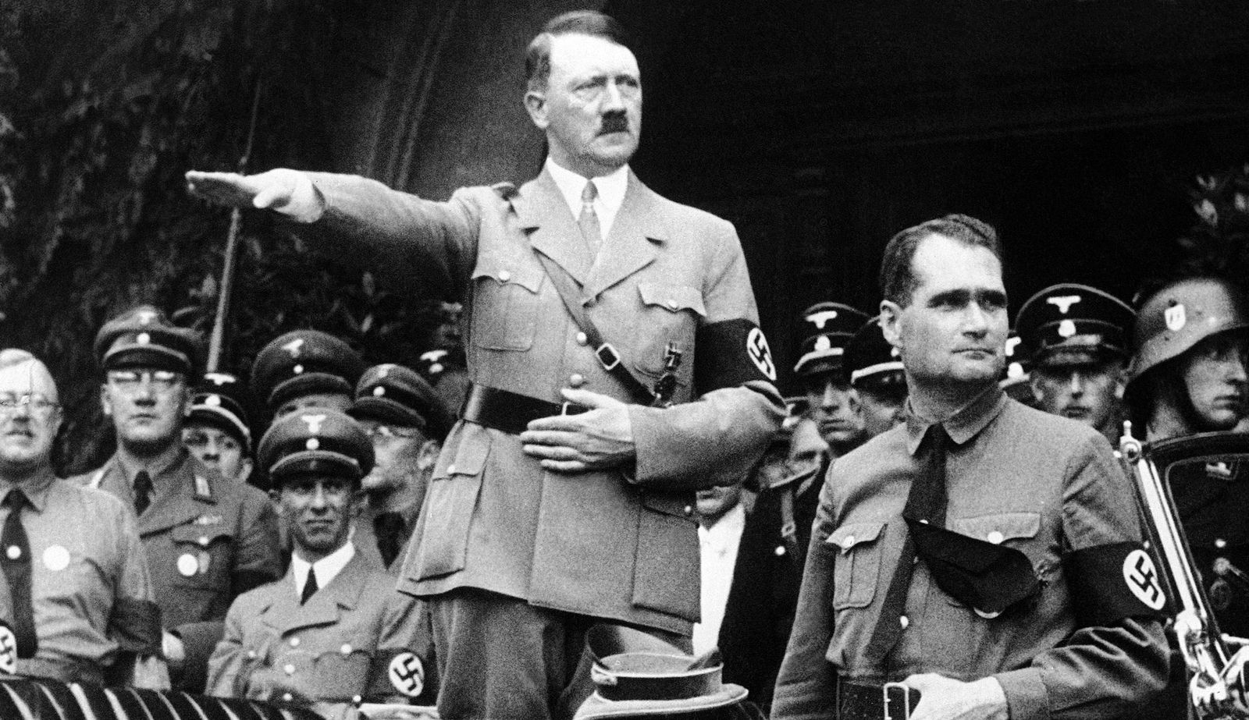

Slide 4
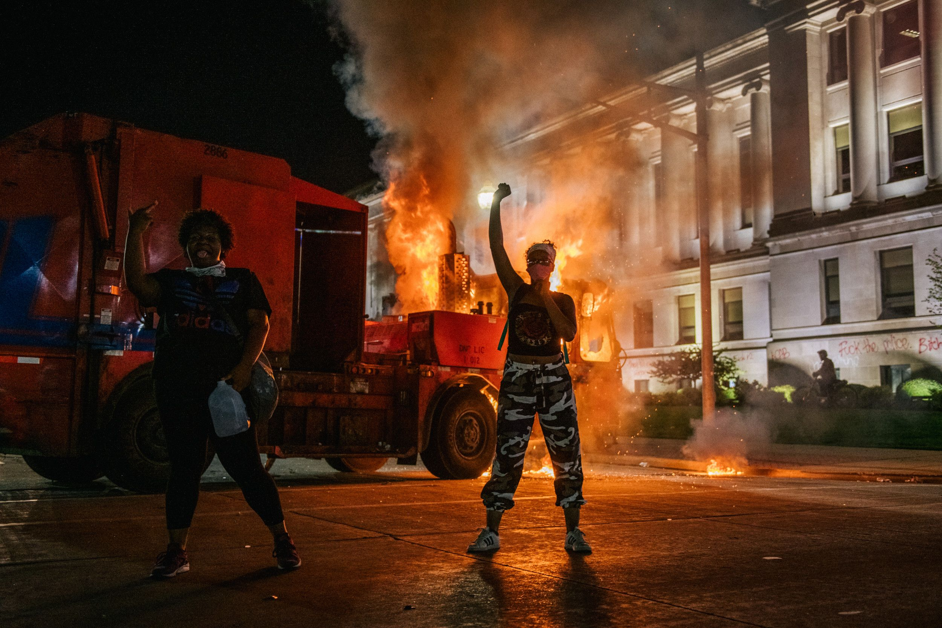

Slide 6
Ephesians 1:18-23
“I pray that the eyes of your heart may be enlightened in order that you may know the hope to which he has called you, the riches of the glory of his inheritance in his holy ones, and his incomparably great power for us who believe. That power is the same as the mighty strength he exerted when he raised Christ from the dead and seated him at his right hand in the heavenly realms, far above all rule and authority, power and dominion, and every name that is named, not only in the present age but also in the one to come. And God placed all things under his feet and appointed him to be head over everything for the church, which is his body, the fullness of him who fills everything in every way.”

Slide 7
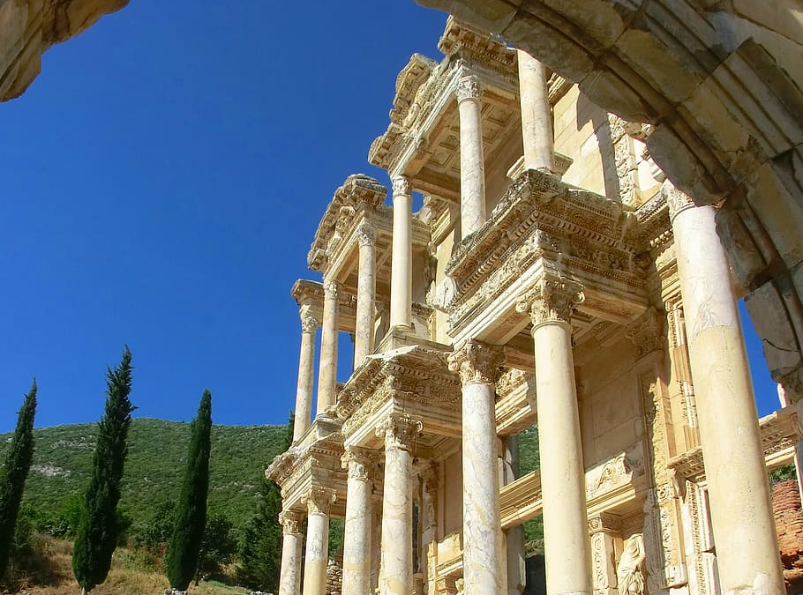
Paul’s Letter to the Ephesians
1:18-23

Slide 8
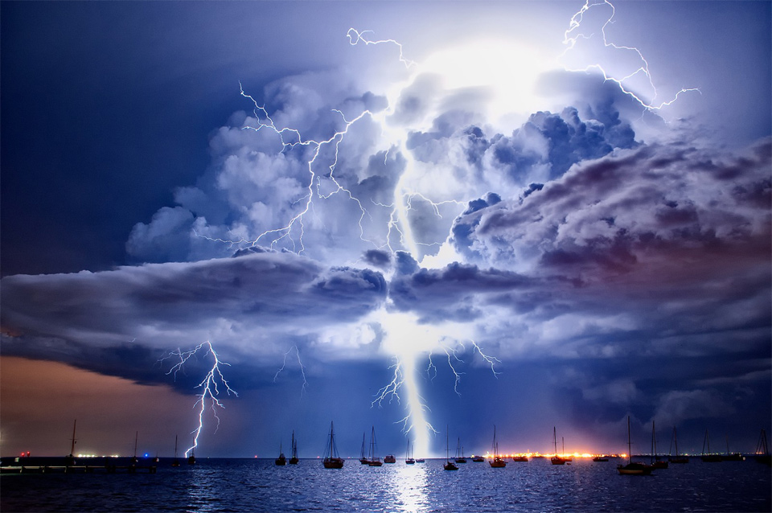
“his incomparably great power for us who believe.”

Slide 9
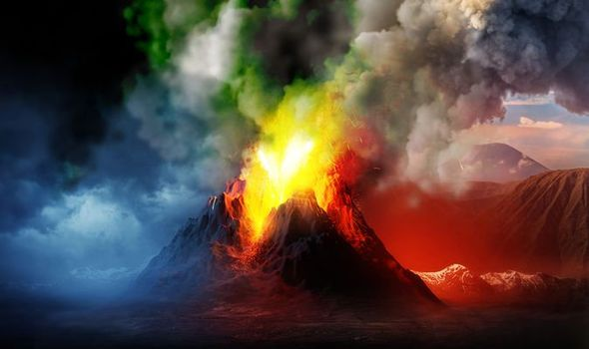
“That power is the same as the mighty strength he exerted when he raised Christ from the dead”

Slide 10
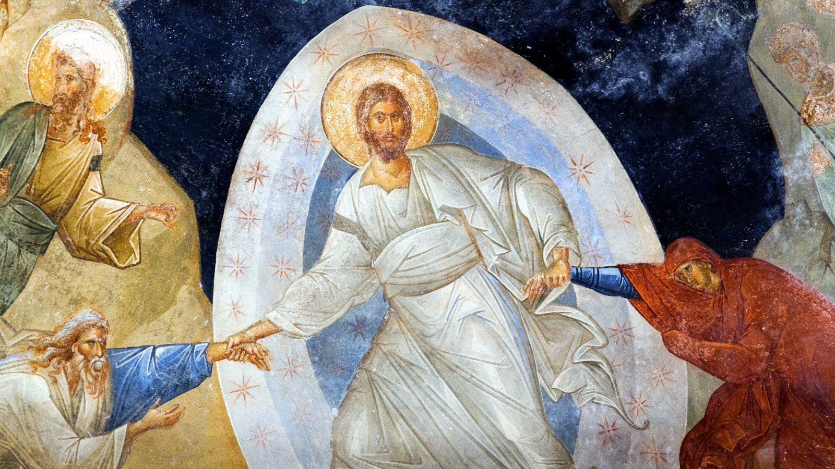
“That power is the same as the mighty strength he exerted when he raised Christ from the dead”

Slide 11
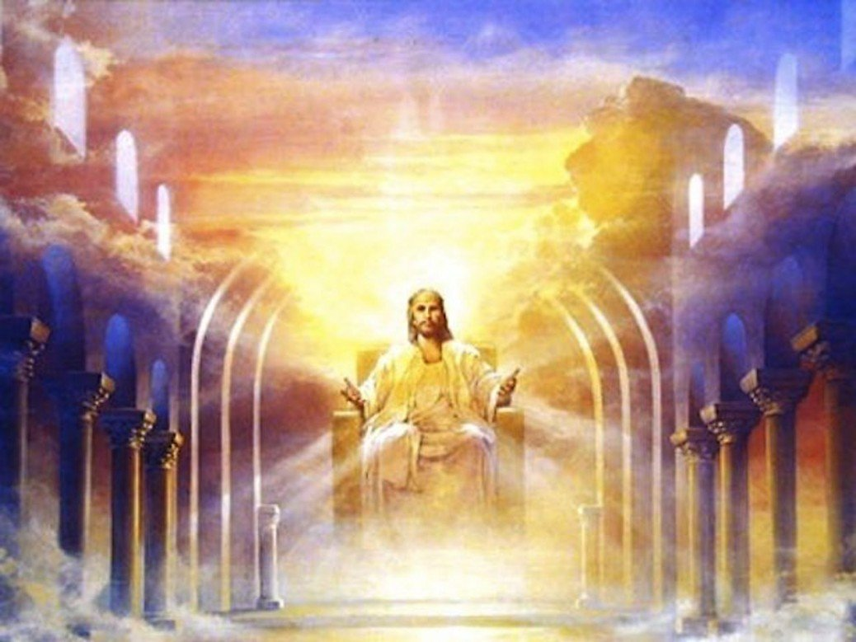
“and seated him at his right hand in the heavenly realms”

Slide 12
Psalm 110:1
“Yahweh said to my Lord,
‘Sit at my right hand until I make your enemies a footstool for your feet’.”

Slide 13
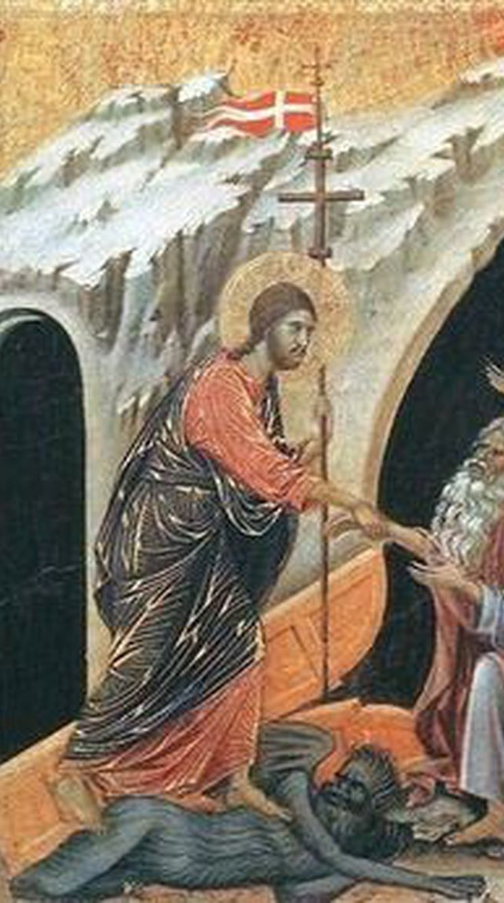
Psalm 110:1
“Yahweh said to my Lord,
‘Sit at my right hand until I make your enemies a footstool for your feet’.”

Slide 14
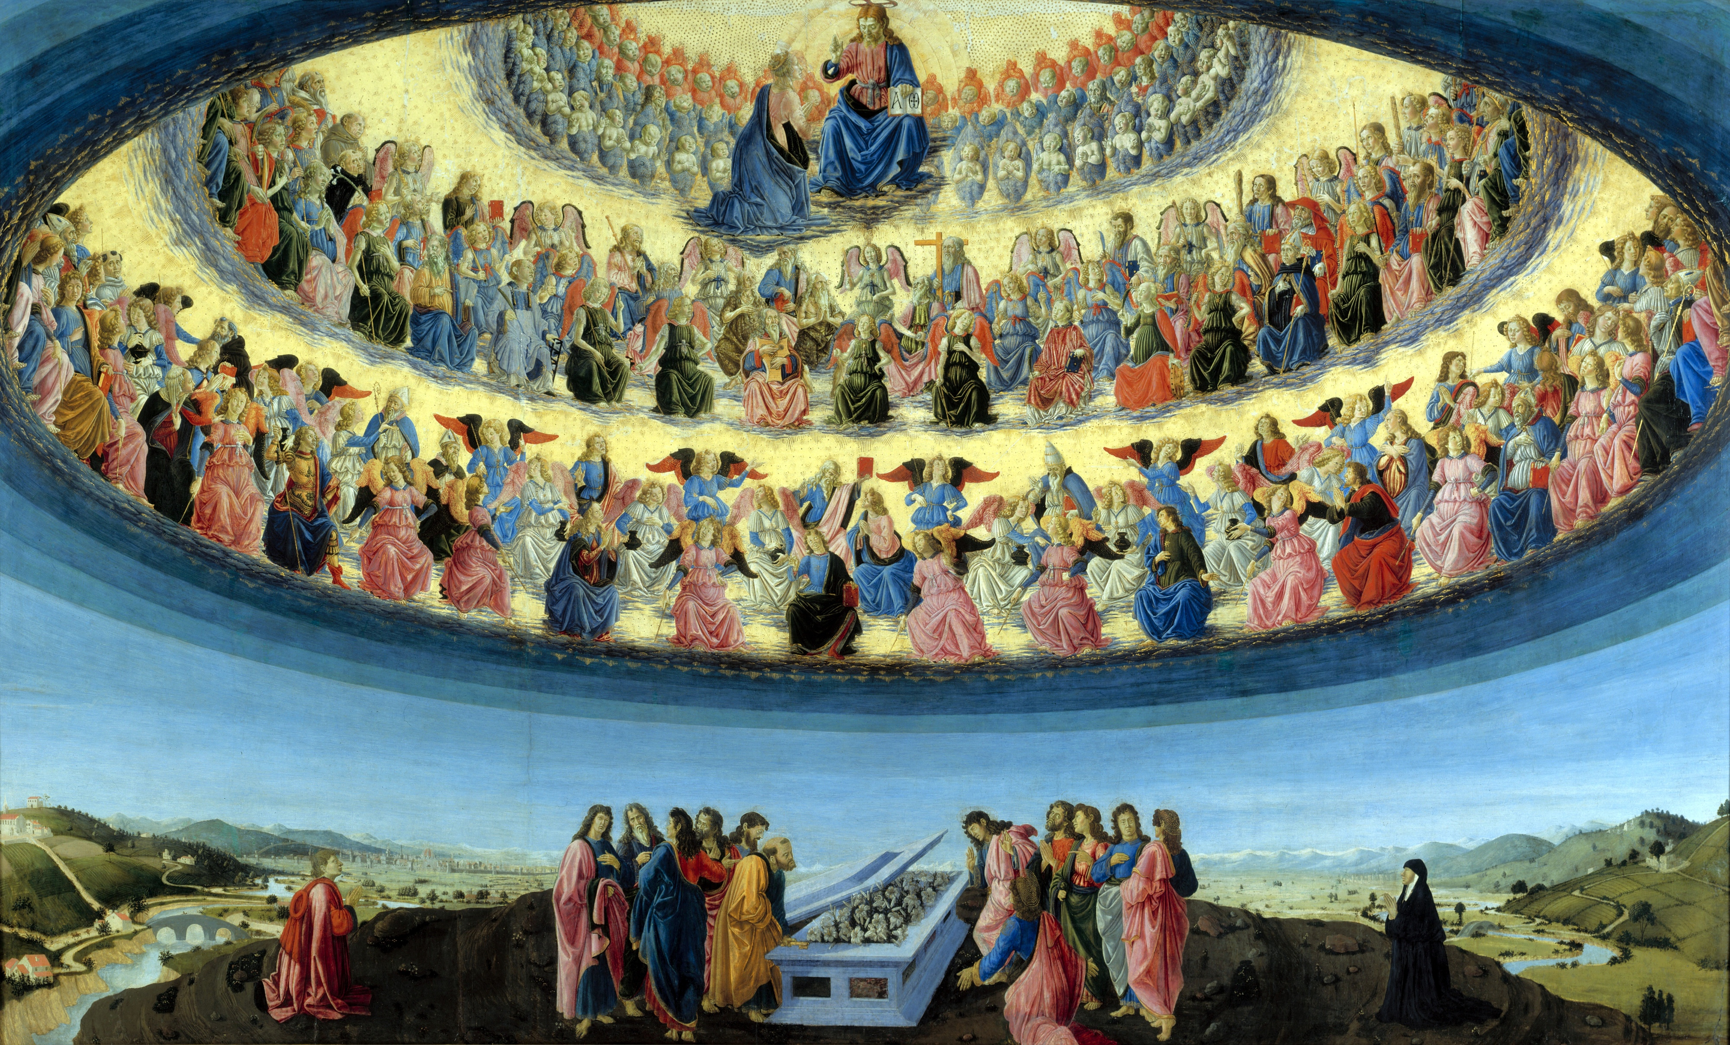
“…far above all rule and authority, power and dominion, and every name that is named, not only in the present age but also in the one to come.”

Slide 15
“And God placed all things under his feet and appointed him to be head over everything for the church, which is his body, the fullness of him who fills everything in every way.”

Slide 16
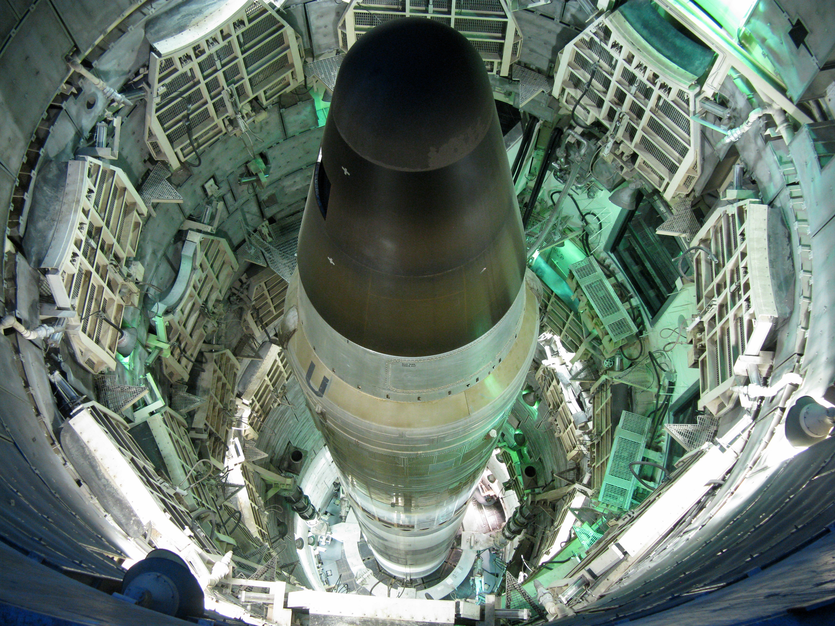

Slide 18
To give your offerings online, you can do so at:
holytrinitychico.org
To give you offerings via check, please mail them to:
Holy Trinity Church
1394 Huggins Ave.
Chico, CA 95926

