Slide 1
Matthew 2:1-12
“After Jesus was born in Bethlehem in Judea, during the time of King Herod, Magi from the east came to Jerusalem and asked, “Where is the one who has been born king of the Jews? We saw his star when it rose and have come to worship him.”
Warrior God, Forever Father,
Shalom bringer.

Slide 2
“When King Herod heard this he was disturbed, and all Jerusalem with him. When he had called together all the people’s chief priests and teachers of the law, he asked them where the Messiah was to be born. “In Bethlehem in Judea,” they replied, “for this is what the prophet has written:
‘But you, Bethlehem, in the land of Judah, are by no means least among the rulers of Judah; for out of you will come a ruler who will shepherd my people Israel.’
Warrior God, Forever Father,
Shalom bringer.

Slide 3
“Then Herod called the Magi secretly and found out from them the exact time the star had appeared. He sent them to Bethlehem and said, “Go and search carefully for the child. As soon as you find him, report to me, so that I too may go and worship him.”
Warrior God, Forever Father,
Shalom bringer.

Slide 4
“After they had heard the king, they went on their way, and the star they had seen when it rose went ahead of them until it stopped over the place where the child was. When they saw the star, they were overjoyed. On coming to the house, they saw the child with his mother Mary, and they bowed down and worshiped him. Then they opened their treasures and presented him with gifts of gold, frankincense and myrrh. And having been warned in a dream not to go back to Herod, they returned to their country by another route.”
Warrior God, Forever Father,
Shalom bringer.

Slide 5
Week 4 - “Worshipping”
Matthew 2:1-12

Slide 6
King Herod

Slide 7
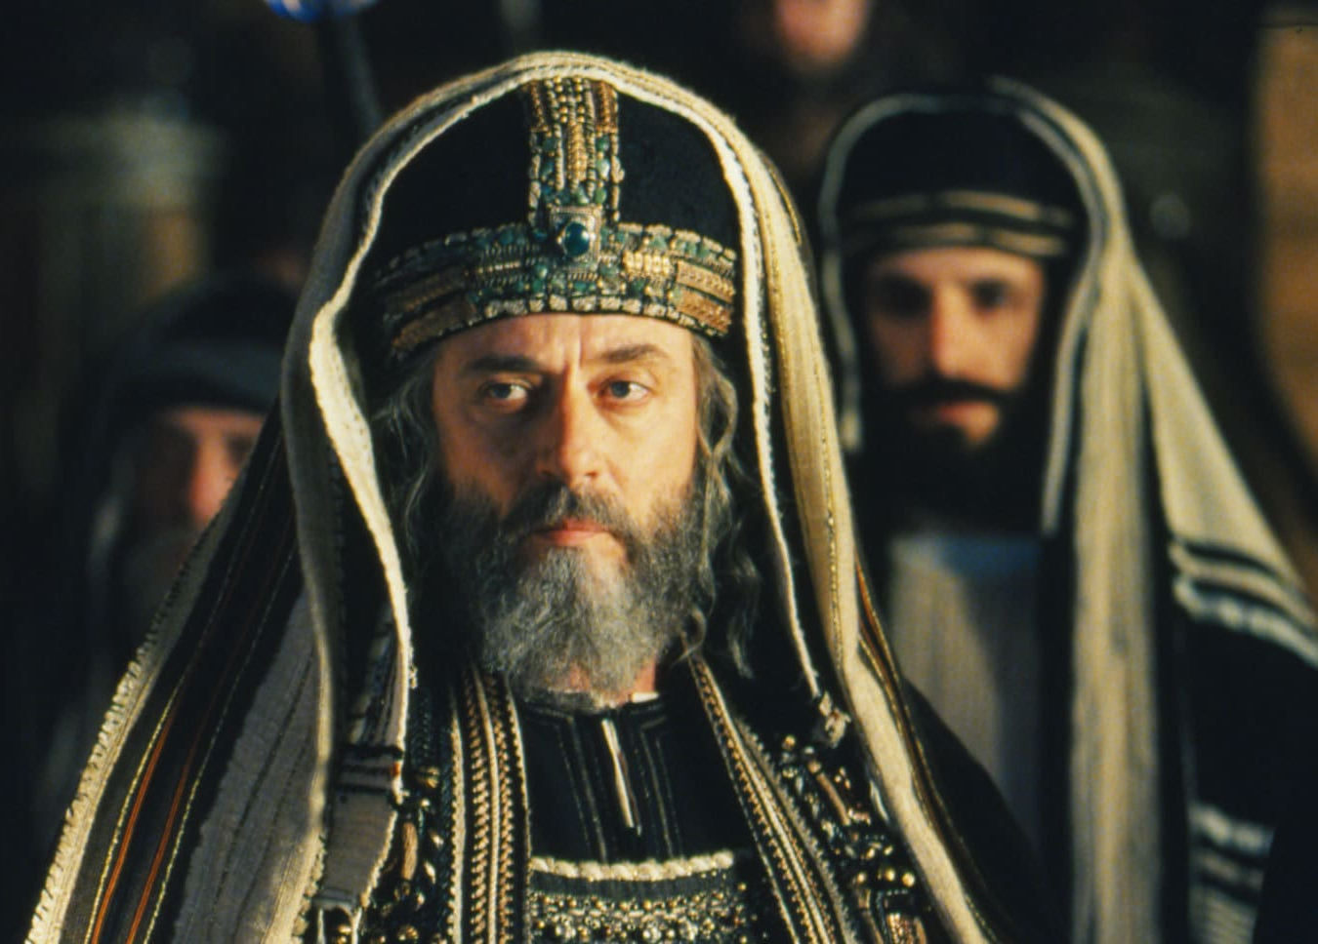
Chief priests and teachers of the law

Slide 8
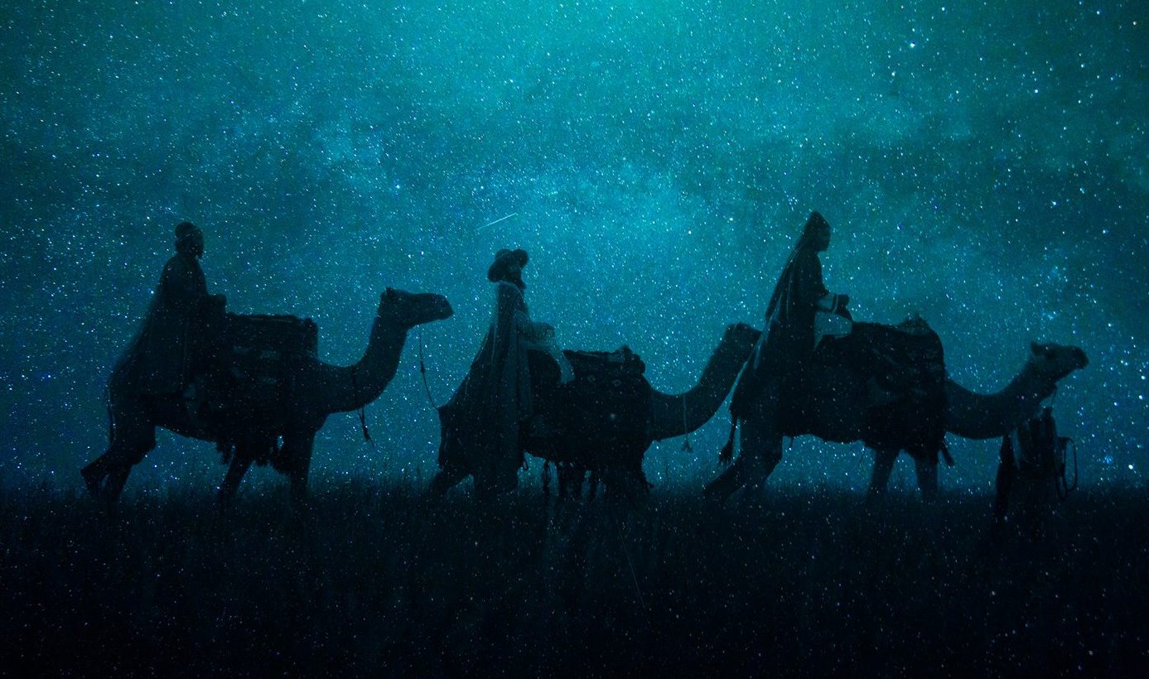
Magi

Slide 9
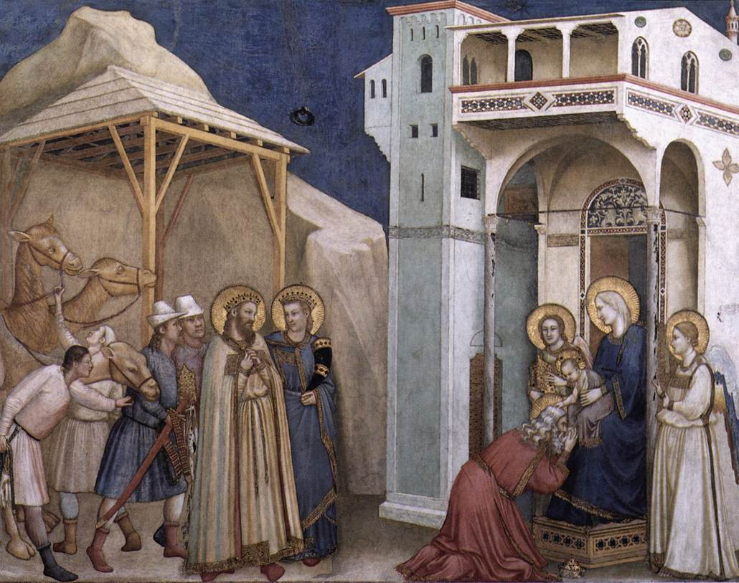

Slide 11
