Slide 1
Ephesians 3:14-19
“For this reason I bow my knees before the Father, from whom the whole family in heaven and on earth is named, that according to the riches of his glory he may grant you to be strengthened with power through his Spirit in your inner being, so that Christ may dwell in your hearts through faith—that you, being rooted and grounded in love, may have strength to comprehend with all the holy ones what is the breadth and length and height and depth, and to know the love of Christ that surpasses knowledge, that you may be filled with all the fullness of God.”

Slide 3
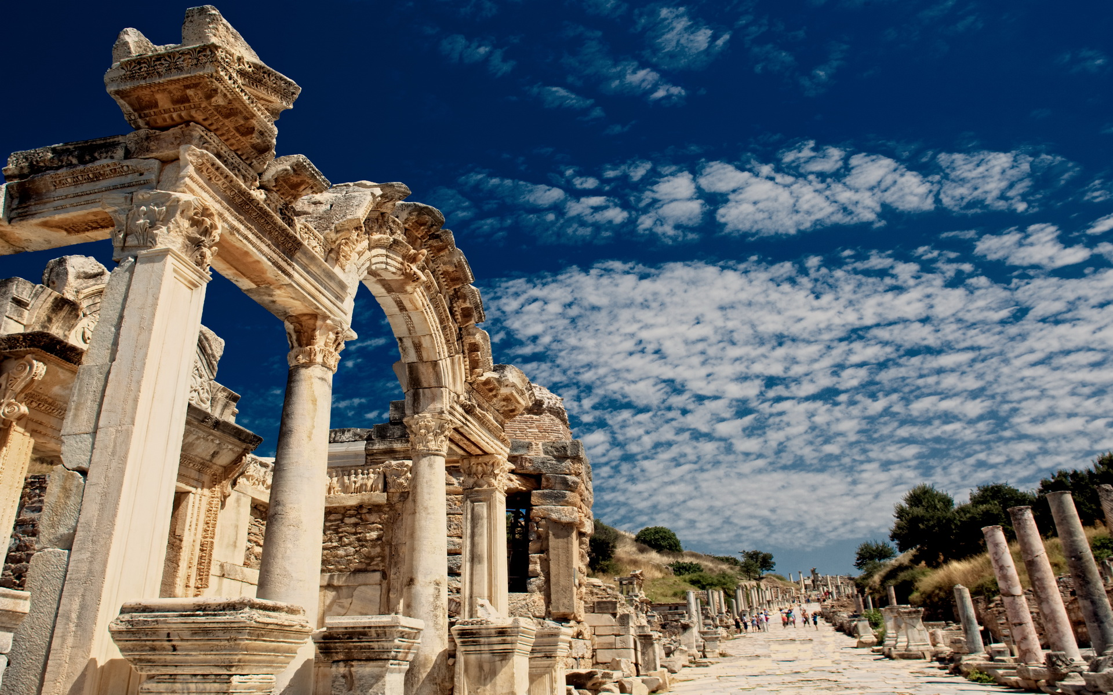
Paul’s Letter to the Ephesians
Eph 3:16-19

Slide 4
Ephesians 3:14-19
“For this reason I bow my knees before the Father, from whom the whole family in heaven and on earth is named, that according to the riches of his glory he may grant you to be strengthened with power through his Spirit in your inner being, so that Christ may dwell in your hearts through faith—that you, being rooted and grounded in love, may have strength to comprehend with all the holy ones what is the breadth and length and height and depth, and to know the love of Christ that surpasses knowledge, that you may be filled with all the fullness of God.”

Slide 5
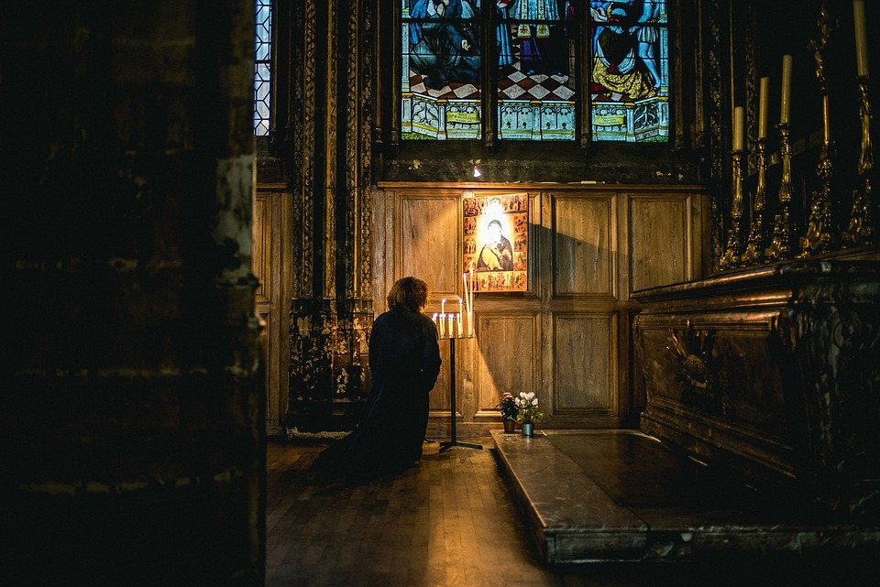
“For this reason I bow my knees before the Father, from whom the whole family in heaven and on earth is named”

Slide 6
“that according to the riches of his glory he may grant you to be strengthened with power through his Spirit in your inner being,”

Slide 7
“so that Christ may dwell in your hearts through faith”

Slide 8
“that you, being rooted and grounded in love, may have strength to comprehend with all the holy ones what is the breadth and length and height and depth, and to know the love of Christ that surpasses knowledge, that you may be filled with all the fullness of God.”

Slide 9
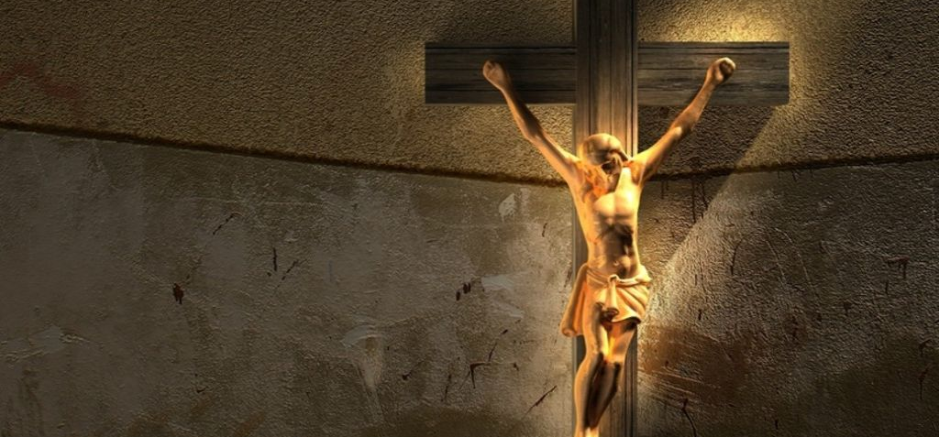
John 15:9
“As the Father has loved me, so have I loved you.”
John 17:23
“I in them and you in me, that they may become perfectly one, so that the world may know that you sent me and loved them even as you loved me.”

Slide 10
John 5:42-44
“I know that you do not have the love of God within you.”
Jude 21
“… keep yourselves in the love of God…”

