Slide 1
Stewards of God’s grace
Eph. 3:1-2

Slide 2
Eph. 3:1-13
For this reason I, Paul, a prisoner of Christ Jesus on behalf of you Gentiles— ² assuming that you have heard of the stewardship of God’s grace that was given to me for you, ³ how the mystery was made known to me by revelation, as I have written briefly. ⁴ When you read this, you can perceive my insight into the mystery of Christ, ⁵ which was not made known to the sons of men in other generations as it has now been revealed to his holy apostles and prophets by the Spirit. ⁶ This mystery is that the Gentiles are fellow heirs, members of the same body, and partakers of the promise in Christ Jesus through the gospel.

Slide 3
Eph. 3:1-13
⁷ Of this gospel I was made a minister according to the gift of God’s grace, which was given me by the working of his power. ⁸ To me, though I am the very least of all the saints, this grace was given, to preach to the Gentiles the unsearchable riches of Christ, ⁹ and to bring to light for everyone what is the plan of the mystery hidden for ages in God, who created all things, ¹⁰ so that through the church the manifold wisdom of God might now be made known to the rulers and authorities in the heavenly places. ¹¹ This was according to the eternal purpose that he has realized in Christ Jesus our Lord, ¹² in whom we have boldness and access with confidence through our faith in him. ¹³ So I ask you not to lose heart over what I am suffering for you, which is your glory.

Slide 4
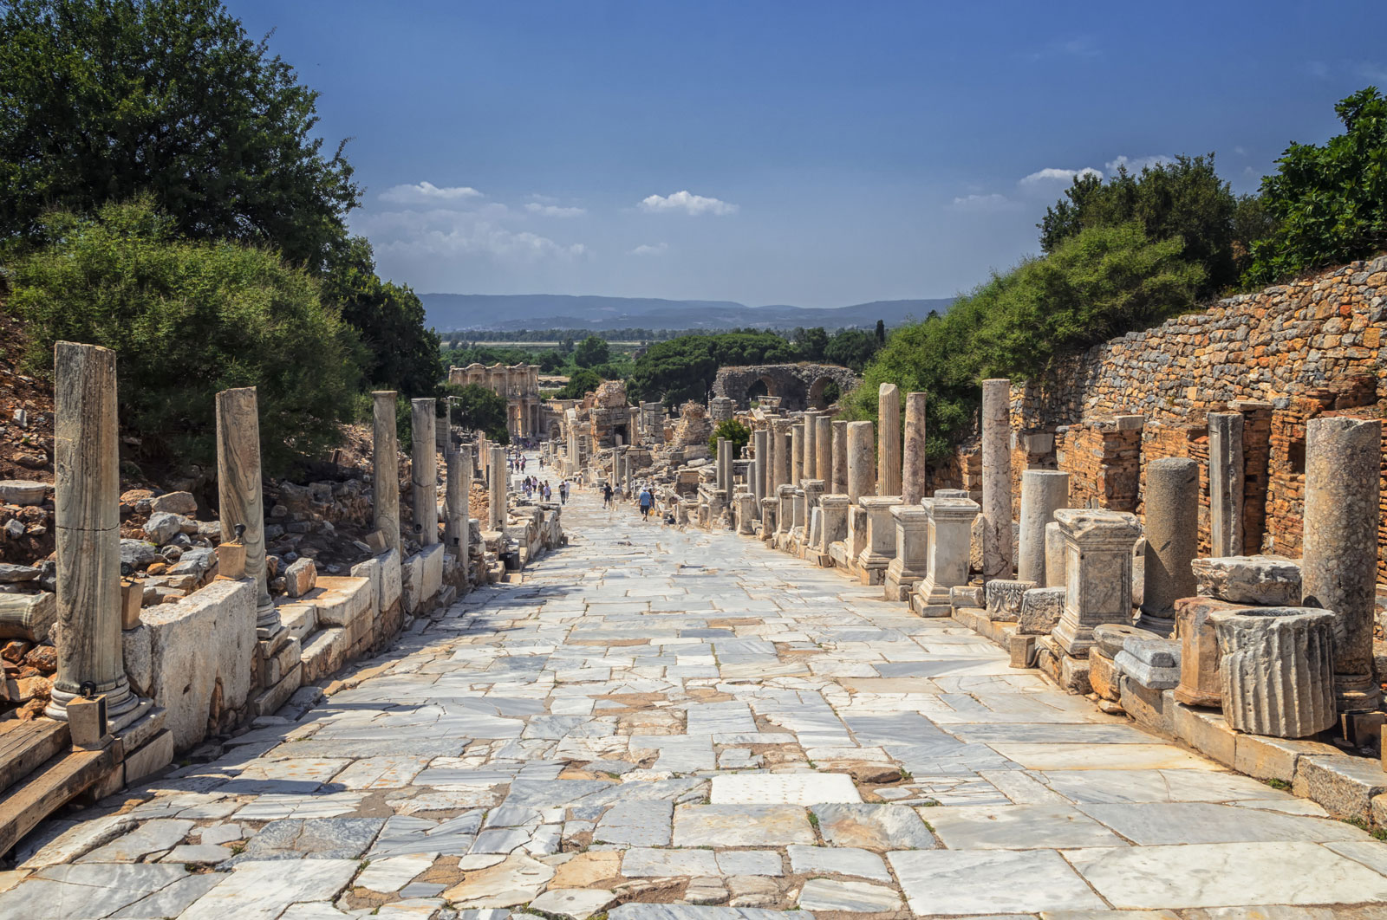
Paul’s Letter to the Ephesians
3:1-2

Slide 5
The Great Tangent
For this reason – 3:1, 3:14
Parenthesis
Paul’s Audience
Paul’s Suffering
Paul’s Message

Slide 6
Paul’s Message
Vs. 6 – This mystery is that through the Gospel the Gentiles are heirs together with Israel, members together of one body, and sharers together in the promise in Christ Jesus.

Slide 7
Stewardship of God’s Grace
Stewardship (Oikonomia) – Administration, Management
Grace (Charis, Charitos) – Endowment, Grant
This Photo by Unknown Author is licensed under CC BY

Slide 8
Stewards of God’s Grace
1 Pet 4:10-11 – 10 Each of you should use whatever gift you have received to serve others, as faithful stewards of God’s grace in its various forms. 11 If anyone speaks, they should do so as one who speaks the very words of God. If anyone serves, they should do so with the strength God provides, so that in all things God may be praised through Jesus Christ. To him be the glory and the power for ever and ever. Amen. NIV

Slide 9
Gifts, Graces & Endowments
Rom 12:3-8 - 3 For by the grace given me I say to every one of you: Do not think of yourself more highly than you ought, but rather think of yourself with sober judgment, in accordance with the faith God has distributed to each of you. 4 For just as each of us has one body with many members, and these members do not all have the same function, 5 so in Christ we, though many, form one body, and each member belongs to all the others. 6 We have different gifts, according to the grace given to each of us. If your gift is prophesying, then prophesy in accordance with your faith; 7 if it is serving, then serve; if it is teaching, then teach; 8 if it is to encourage, then give encouragement; if it is giving, then give generously; if it is to lead, do it diligently; if it is to show mercy, do it cheerfully. NIV

Slide 10
Rom 12: 6-8
Prophesying
Serving
Teaching
Encouraging
Giving
Leading
Mercy
This Photo by Unknown Author is licensed under CC BY

Slide 11
Audience
Personal Spheres
People, Places and passions
This Photo by Unknown Author is licensed under CC BY

Slide 12
People
Homeless, College Students, Retired People, Children, Minorities, Immigrants, Native Americans, Hmong, Prisoners, Learning Disabilities, Fire Victims, Business People, Farmers, Medical Community, Deaf Community, Government Workers, Law Enforcement or Fire Fighters
This Photo by Unknown Author is licensed under CC BY

Slide 13
Places
Your Own Neighborhood, Nord, One Mile, Downtown, California Park, Chapman Town, Paradise, Holy Trinity Neighbors, Other Communities in California, Other Nations
This Photo by Unknown Author is licensed under CC BY-SA

Slide 14
passions
Golfers, Kids Sports, Theatre, Arts, Family, Craft Brewery, Home and Garden, Farmer’s Market, Education, Gaming, Local History, Bridge Club, Service Organization
This Photo by Unknown Author is licensed under CC BY-SA

Slide 15
Sacrifice (Suffering)
3:1 – the prisoner of Christ Jesus for the sake of you Gentiles
3:13 – I ask, you, therefore, not to be discouraged because of my sufferings for you, which are your glory
This Photo by Unknown Author is licensed under CC BY-NC-ND

Slide 16
Stewardship of God’s Grace
What is your gift?
Who is your audience
Are you prepared for opposition?

