Slide 1
Ephesians 3:16-19
“I pray… that according to the riches of his glory, he may grant you to be strengthened with power through his Spirit in your inner being, that Christ may dwell in your hearts through faith—that you, being rooted and grounded in love, may have strength to comprehend with all the holy ones what is the breadth and length and height and depth, and to know the love of Christ that surpasses knowledge, that you may be filled with all the fullness of God.”

Slide 2
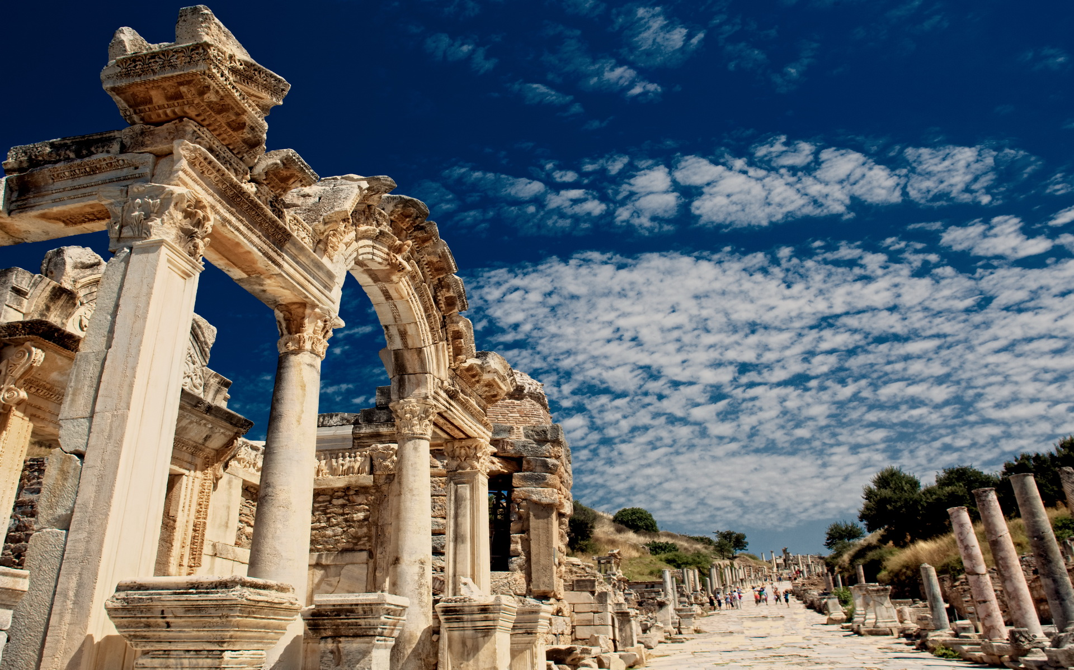
Paul’s Letter to the Ephesians
Eph 3:16-19

Slide 3
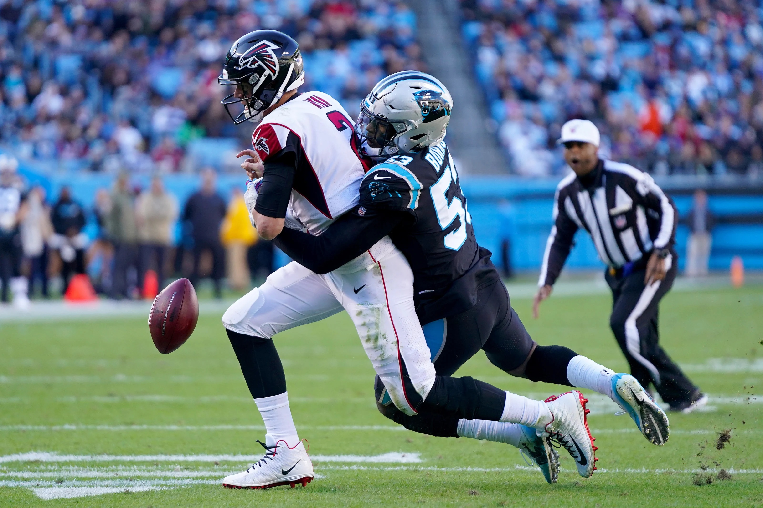

Slide 4
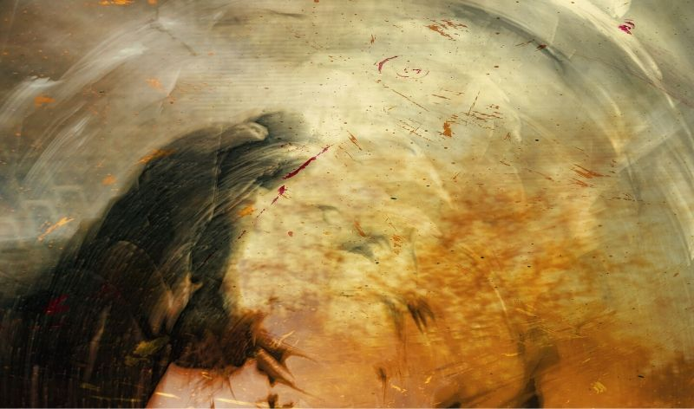

Slide 5
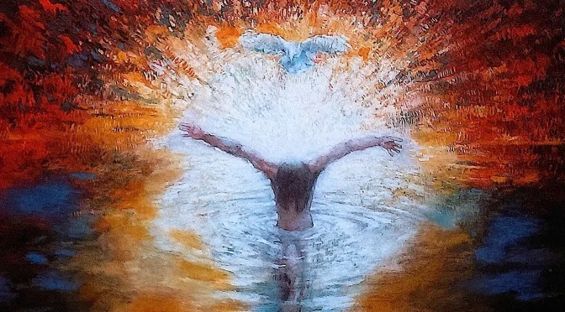

Slide 6
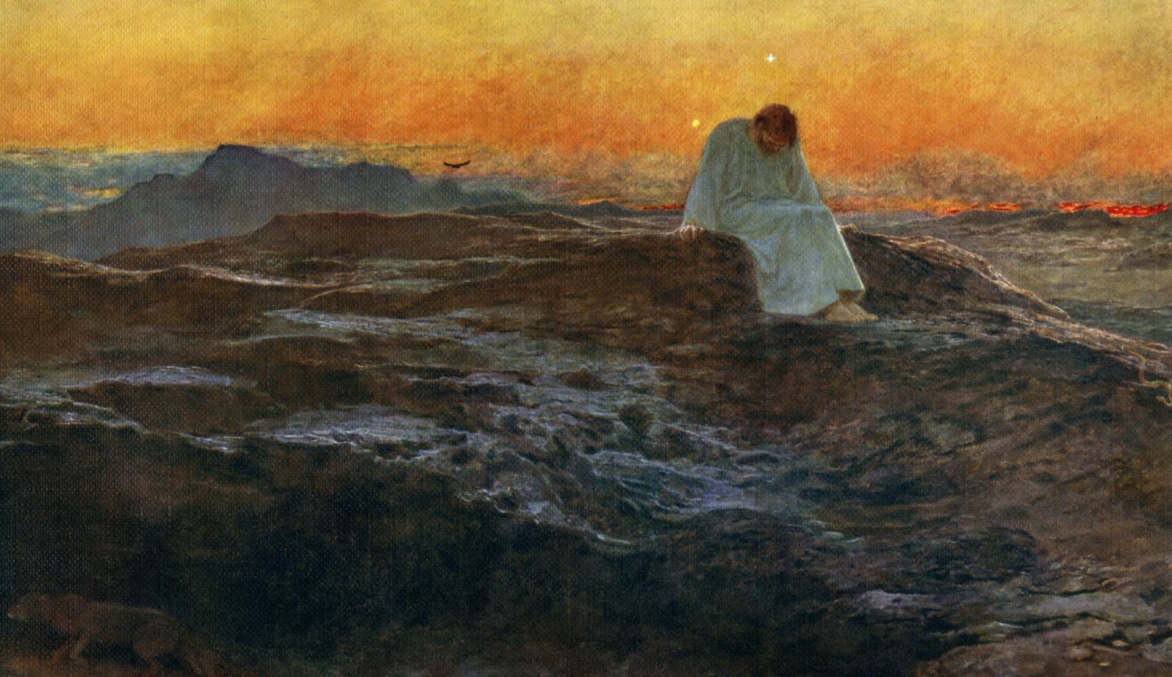

Slide 7
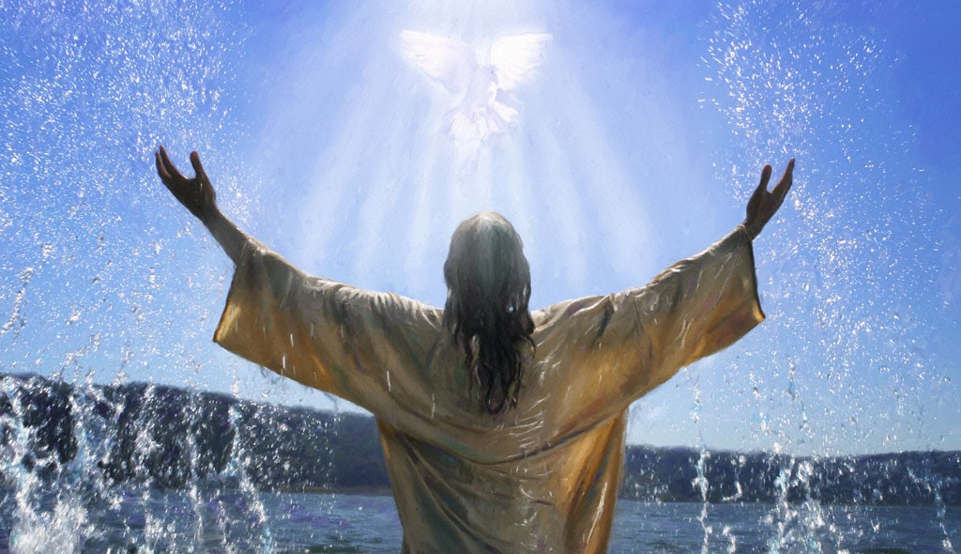

Slide 8
Who are you?

Slide 9
Who are you?
Doctor
Programmer
Mother
Retired
Student

Slide 10
Who are you?
Doctor
Programmer
Mother
Retired
Student

Slide 11
Who are you?
“The Beloved of God”
Yediydiah

