Slide 1
It is Written

Slide 2
Luke 24:36-49
36 As they were talking about these things, Jesus himself stood among them, and said to them, “Peace to you!” 37 But they were startled and frightened and thought they saw a spirit. 38 And he said to them, “Why are you troubled, and why do doubts arise in your hearts? 39 See my hands and my feet, that it is I myself. Touch me, and see. For a spirit does not have flesh and bones as you see that I have.” 40 And when he had said this, he showed them his hands and his feet. 41 And while they still disbelieved for joy and were marveling, he said to them, “Have you anything here to eat?” 42 They gave him a piece of broiled fish, 43 and he took it and ate before them.

Slide 3
Luke 24:36-49
44 Then he said to them, “These are my words that I spoke to you while I was still with you, that everything written about me in the Law of Moses and the Prophets and the Psalms must be fulfilled.” 45 Then he opened their minds to understand the Scriptures, 46 and said to them, “Thus it is written, that the Christ should suffer and on the third day rise from the dead, 47 and that repentance for the forgiveness of sins should be proclaimed in his name to all nations, beginning from Jerusalem. 48 You are witnesses of these things. 49 And behold, I am sending the promise of my Father upon you. But stay in the city until you are clothed with power from on high.”

Slide 4
Moses, Law, Prophets
44 Then he said to them, “These are my words that I spoke to you while I was still with you, that everything written about me in the Law of Moses and the Prophets and the Psalms must be fulfilled.” 45 Then he opened their minds to understand the Scriptures

Slide 5
Scot McKnight
“The Gospel is the story of Jesus of Nazareth told as the climax of the long story of Israel, which in turn is the story of how the one true God is rescuing the world.”
This Photo by Unknown Author is licensed under CC BY-NC

Slide 6
Three Witnesses
Holy Spirit
Scripture
Testimony

Slide 7
Acts 2:14-40
This Photo by Unknown Author is licensed under CC BY-SA-NC

Slide 8
Introduction
17 “ ‘In the last days, God says,
I will pour out my Spirit on all people.
Your sons and daughters will prophesy,
your young men will see visions,
your old men will dream dreams.
18 Even on my servants, both men and women,
I will pour out my Spirit in those days,
and they will prophesy.
19 I will show wonders in the heavens above
and signs on the earth below,
blood and fire and billows of smoke.
20 The sun will be turned to darkness
and the moon to blood
before the coming of the great and glorious day of the Lord.
21 And everyone who calls
on the name of the Lord will be saved.

Slide 9
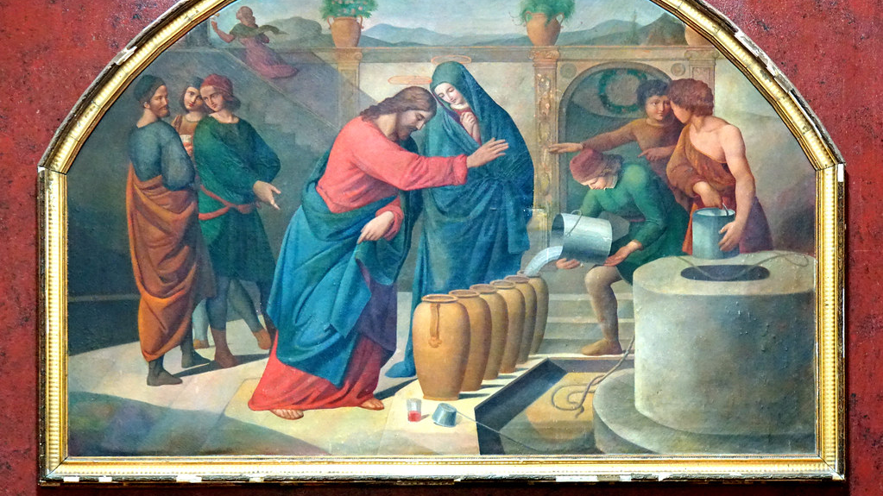
First Text: Joel 2:28-32
Wonders and Signs
Jesus Life, Death and Resurrection
This Photo by Unknown Author is licensed under CC BY-SA

Slide 10
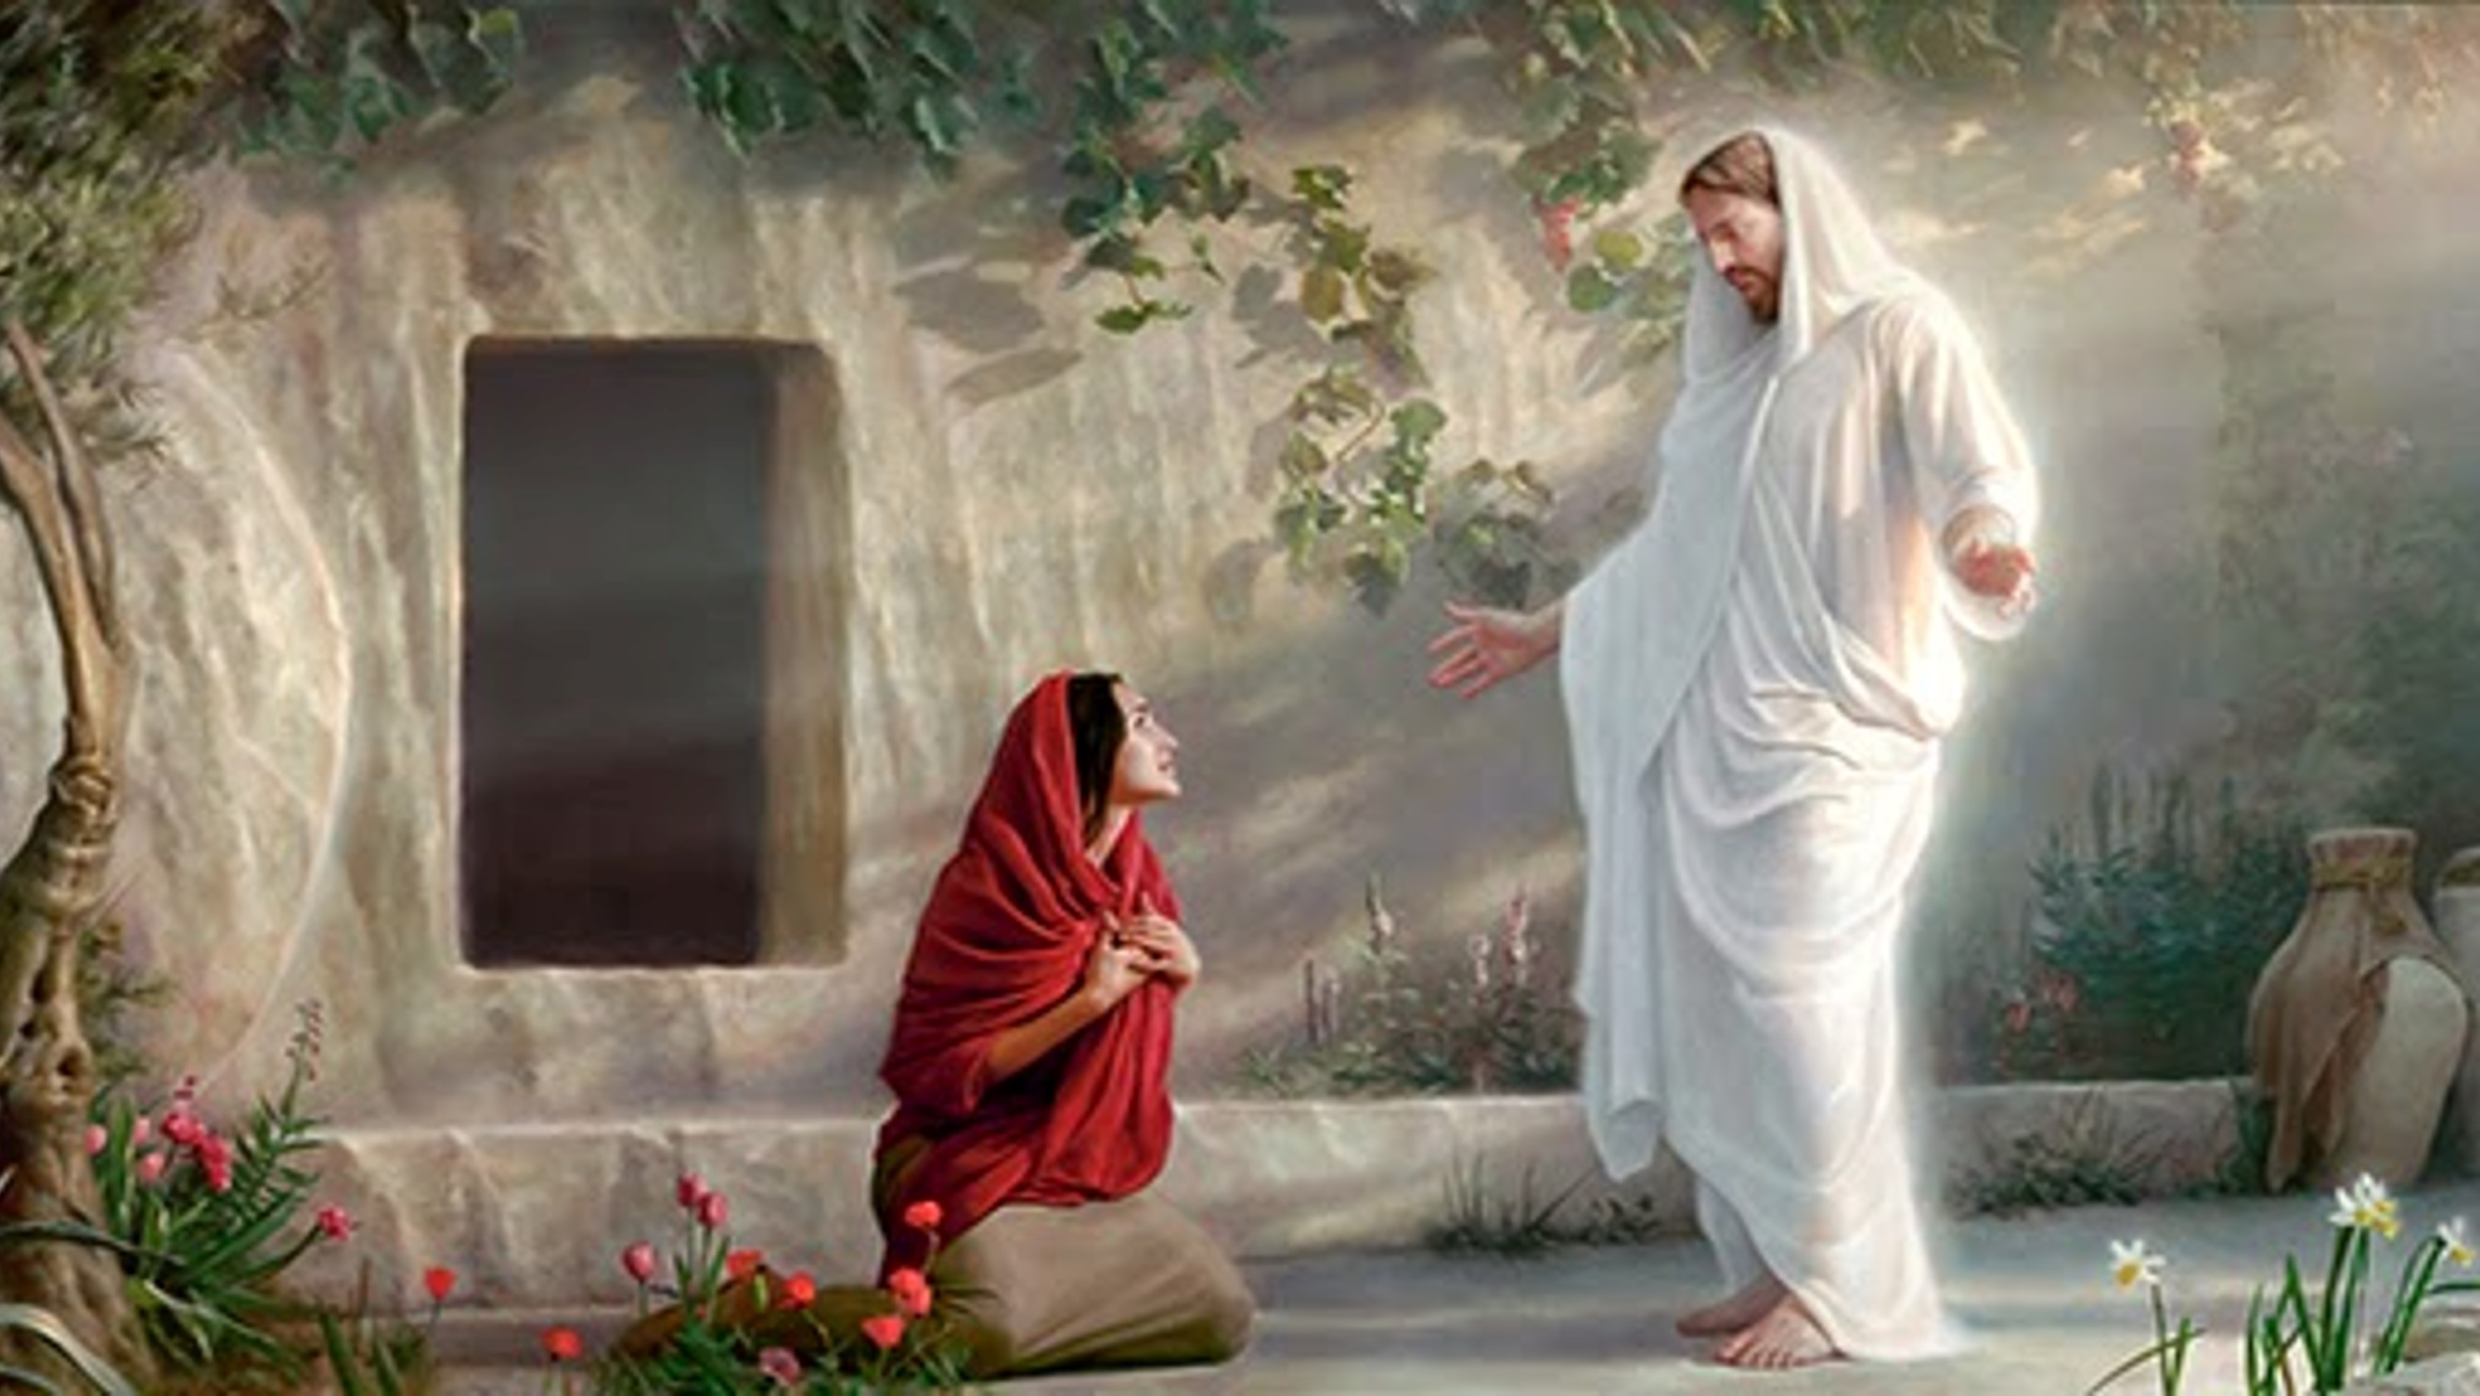
Second Text: Ps. 16:8-11
Resuurection of the Messiah
Realm of the Dead
God’s Oath to David

Slide 11
Third Text: Ps. 110:1
Exalted to God’s Right Hand
Spirit Received and Poured Out

Slide 12
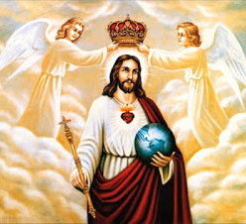
Peter’s Conclusion
Jesus is Lord and Messiah
This Photo by Unknown Author is licensed under CC BY-NC-ND

Slide 13
3 Witnesses
Holy Spirit
People and Disciples
Scriptures

Slide 14
It is Written

