Slide 1
Exodus 33:12-19a
Moses said to Yahweh, “You have been telling me, ‘Lead these people,’ but you have not let me know whom you will send with me. You have said, ‘I know you by name and you have found favor with me.’ If you are pleased with me, teach me your ways so I may know you and continue to find favor with you. Remember that this nation is your people.”
Yahweh replied, “My Presence will go with you, and I will give you rest.”

Slide 2
Then Moses said to him, “If your Presence does not go with us, do not send us up from here. How will anyone know that you are pleased with me and with your people unless you go with us? What else will distinguish me and your people from all the other people on the face of the earth?”
And Yahweh said to Moses, “I will do the very thing you have asked, because I am pleased with you and I know you by name.”
Then Moses said, “Now show me your glory.”
And Yahweh said, “I will cause all my goodness to pass in front of you, and I will proclaim my name, the Lord, in your presence.”

Slide 3
Holy Trinity Church - 2021

Slide 4
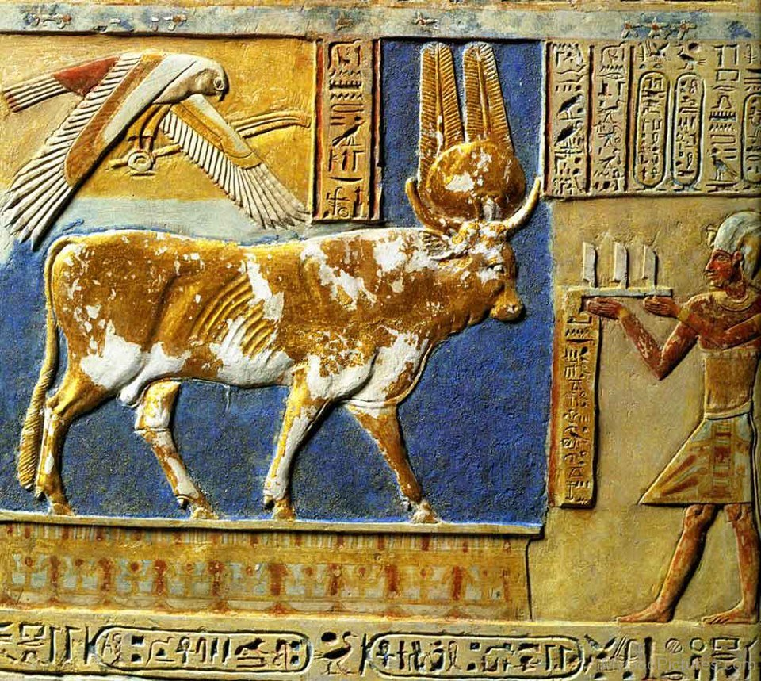

Slide 9
Holy Trinity Chico
Live by faith. Grow in grace.
Walk in love.

Slide 10
Holy Trinity Chico
Live by faith. Grow in grace.
Walk in love.

