Slide 1
Encounter with the Coal
Holy Trinity Church
January 30, 2022
Craig Anderson

Slide 2
Isaiah 6:1-8
In the year that King Uzziah died, I saw the Lord, high and exalted, seated on a throne; and the train of his robe filled the temple. 2 Above him were seraphim, each with six wings: With two wings they covered their faces, with two they covered their feet, and with two they were flying. 3 And they were calling to one another:
“Holy, holy, holy is the LORD Almighty;
the whole earth is full of his glory.”

Slide 3
Isaiah 6: 1-8
4 At the sound of their voices the doorposts and thresholds shook and the temple was filled with smoke.
5 “Woe to me!” I cried. “I am ruined! For I am a man of unclean lips, and I live among a people of unclean lips, and my eyes have seen the King, the LORD Almighty.”
6 Then one of the seraphim flew to me with a live coal in his hand, which he had taken with tongs from the altar. 7 With it he touched my mouth and said, “See, this has touched your lips; your guilt is taken away and your sin atoned for.”
8 Then I heard the voice of the Lord saying, “Whom shall I send? And who will go for us?”
And I said, “Here am I. Send me!”

Slide 4
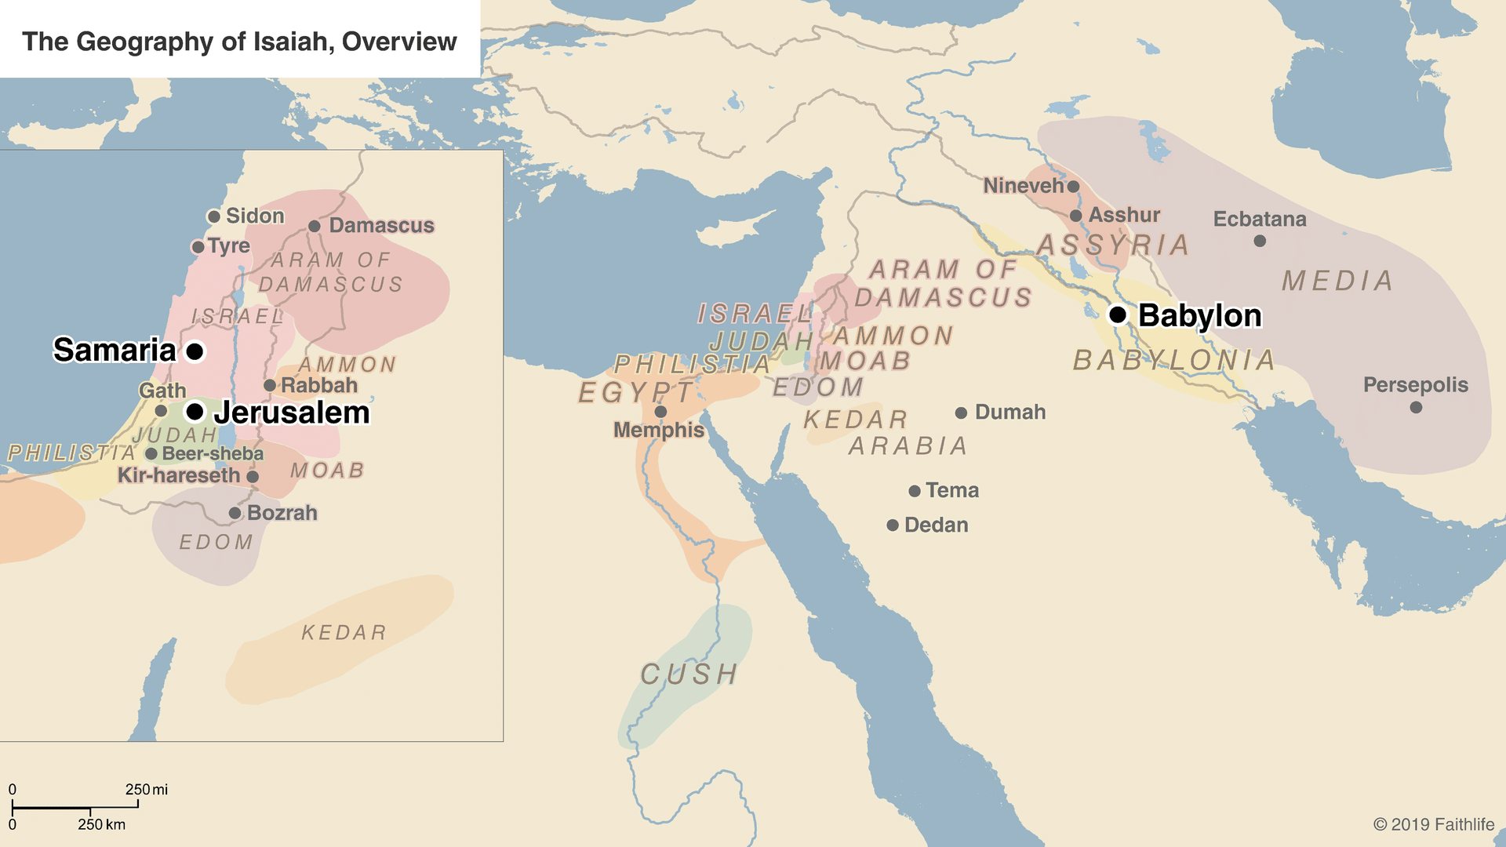

Slide 6
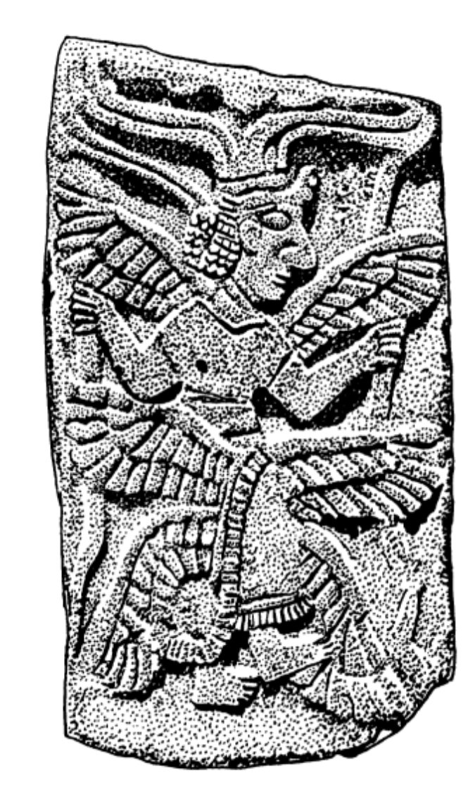

Slide 7
Holy Holy Holy
This Photo by Unknown Author is licensed under CC BY

Slide 8
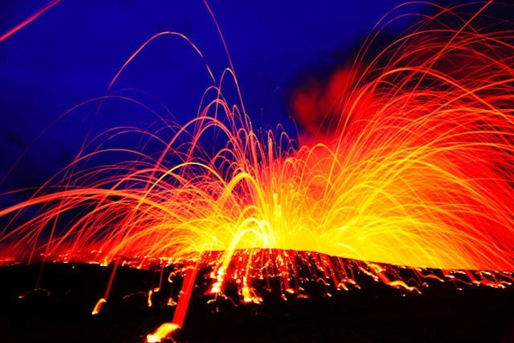
This Photo by Unknown Author is licensed under CC BY-NC-ND

Slide 9
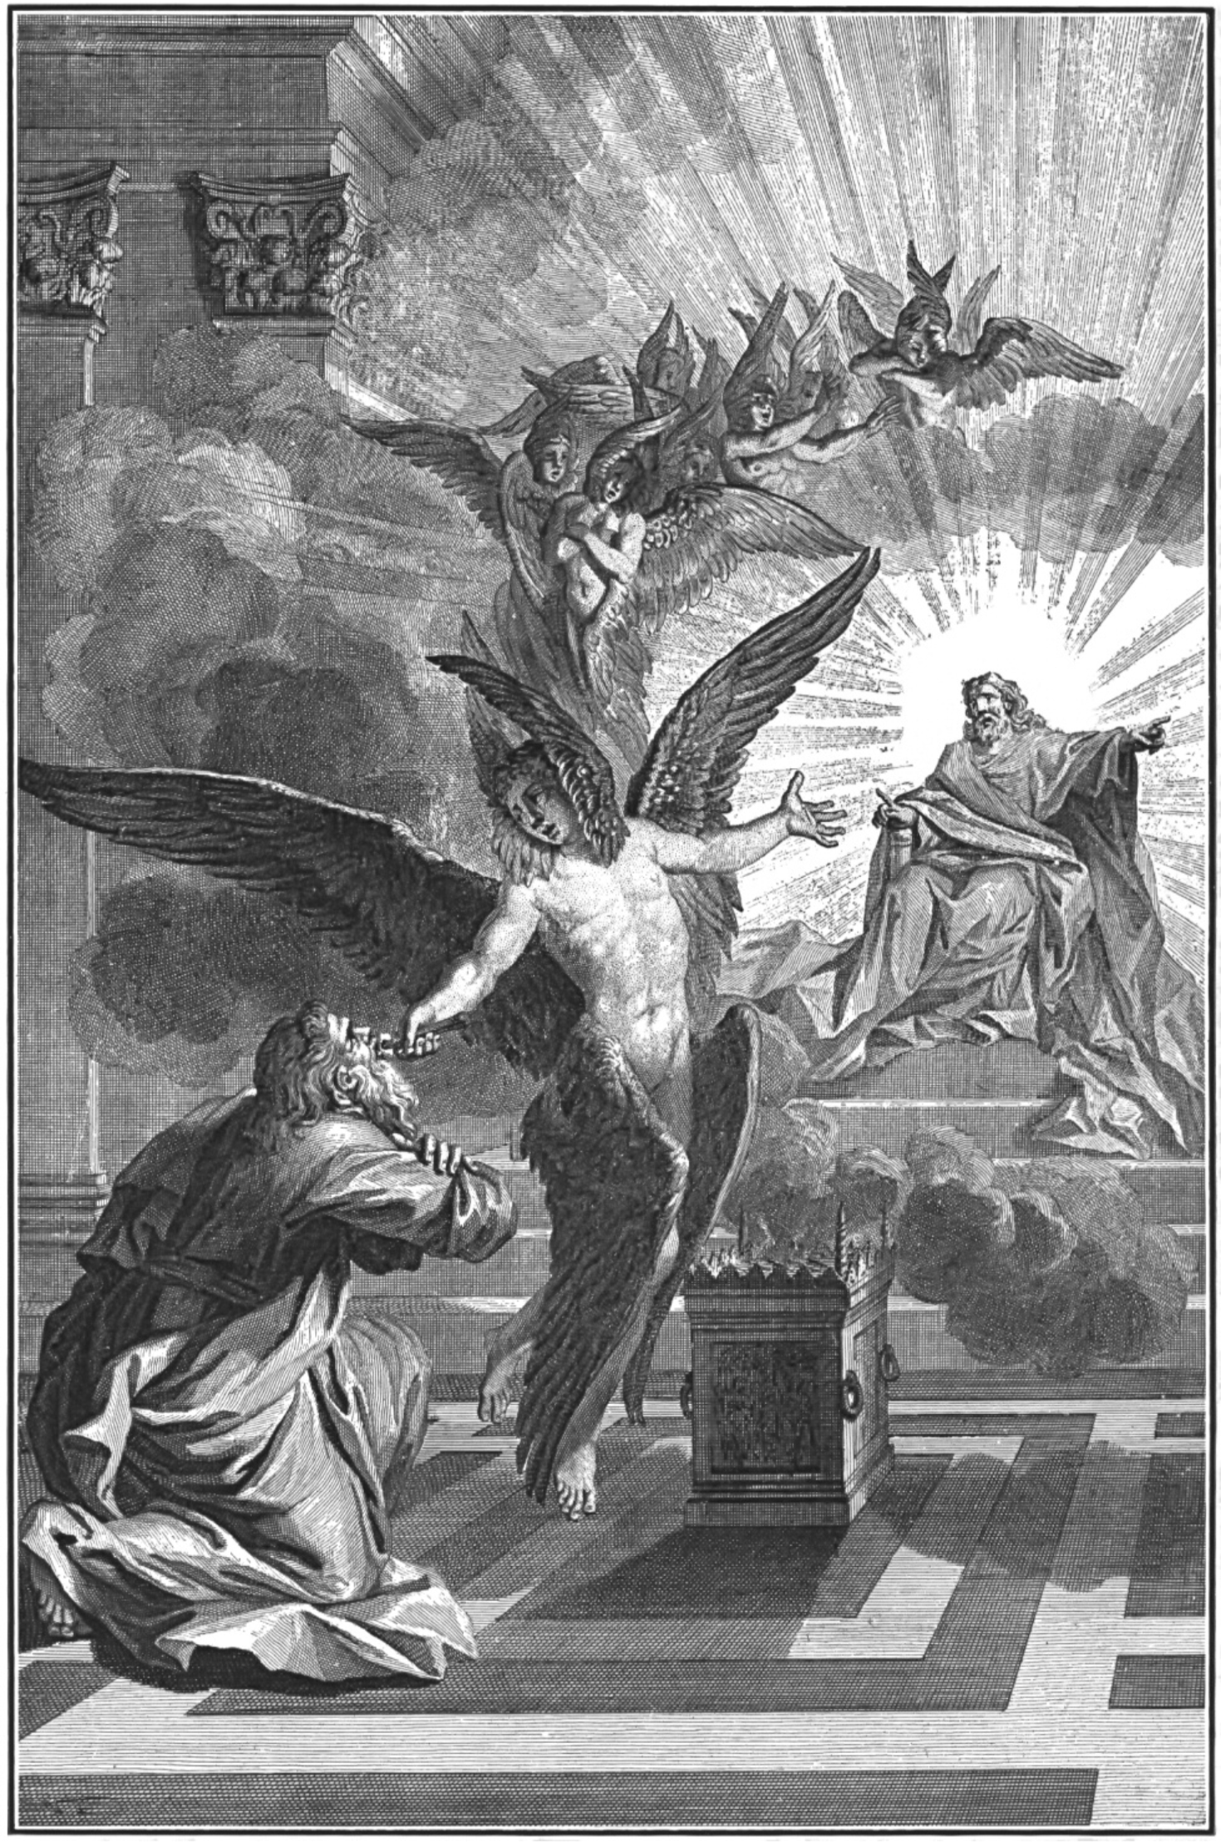

Slide 11
Isa. 33:14 The sinners in Zion are terrified; trembling grips the godless: “Who of us can dwell with the consuming fire? Who of us can dwell with everlasting burning?”

Slide 12
Isaiah 52:13-53:12
This Photo by Unknown Author is licensed under CC BY-SA

