Slide 1
Nicene-Constantinopolitan Creed
Holy Trinity Church
March 20, 2022
Craig Anderson

Slide 2
John 1:1-10
In the beginning was the Word, and the Word was with God, and the Word was God. 2 He was in the beginning with God. 3 All things were made through him, and without him was not any thing made that was made. 4 In him was life, and the life was the light of men. 5 The light shines in the darkness, and the darkness has not overcome it.

Slide 3
John 1:1-10
6 There was a man sent from God, whose name was John. 7He came as a witness, to bear witness about the light, that all might believe through him. 8 He was not the light, but came to bear witness about the light.
9 The true light, which gives light to everyone, was coming into the world. 10 He was in the world, and the world was made through him, yet the world did not know him.

Slide 4
Creeds and Confessions
This Photo by Unknown Author is licensed under CC BY-SA-NC

Slide 5
Deuteronomy 6:4-7
⁴ “Hear, O Israel: The Lord our God, the Lord is one. ⁵ You shall love the Lord your God with all your heart and with all your soul and with all your might. ⁶ And these words that I command you today shall be on your heart. ⁷ You shall teach them diligently to your children, and shall talk of them when you sit in your house, and when you walk by the way, and when you lie down, and when you rise. ⁸ You shall bind them as a sign on your hand, and they shall be as frontlets between your eyes. ⁹ You shall write them on the doorposts of your house and on your gates

Slide 6
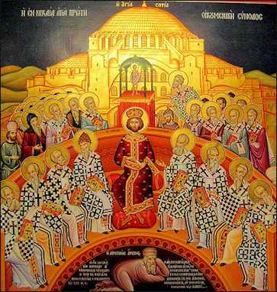
This Photo by Unknown Author is licensed under CC BY-NC-ND

Slide 7
Begotten of the Father

Slide 8
Before All Time
John 1:1-3 - In the beginning was the Word, and the Word was with God, and the Word was God. He was in the beginning with God. All things were made through him, and without him was not any thing made that was made.

Slide 9
God of God… Very God of Very God
Hebrews 1:8 - But of the Son he says, “Your throne, O God, is forever and ever, the scepter of uprightness is the scepter of your kingdom.
John 1:18 No one has ever seen God; the only (begotten) God, who is at the Father’s side (in the bosom of the Father), he has made him known

Slide 10
Light of Light
Rev. 21:23 - And the city has no need of sun or moon to shine on it, for the glory of God gives it light, and its lamp is the Lamb. By its light will the nations walk.
Heb 1:3 - He is the radiance of the glory of God and the exact imprint of his nature, and he upholds the universe by the word of his power.

Slide 11
Begotten not Made
C.S. Lewis - “When you beget, you beget something of the same kind as yourself,” Lewis explains. “A man begets human babies, a beaver begets little beavers and a bird begets eggs which turn into little birds. But when you make, you make something of a different kind from yourself. A bird makes a nest, a beaver builds a dam, a man makes a wireless set (WW II era radio)

Slide 12
Being of One Substance
This Photo by Unknown Author is licensed under CC BY-SA

Slide 13
Burney Falls
This Photo by Unknown Author is licensed under CC BY-ND

Slide 14
Holy Spirit
This Photo by Unknown Author is licensed under CC BY-NC-ND

Slide 15
Church
This Photo by Unknown Author is licensed under CC BY-NC-ND

Slide 16
Baptism
This Photo by Unknown Author is licensed under CC BY-SA-NC

Slide 17
This Photo by Unknown Author is licensed under CC BY-NC-ND

